Slide 1

Online Feedlot Permit Applications
NPDES, SDS, CSF, and Interim permits
wq-f3-60

Slide 2
Tips for navigating this tutorial
Advance slides with a mouse click or arrow keys
  Narration (when available) will start automatically
Hyperlinks allow you to move to a specific section of the tutorial
  Hyperlinks are noted by orange text
Interactive slides require you to click on an object/area of the slide to see information
  These are marked with in the upper left corner
Interactive
Notes:
Here are some tips for navigating this tutorial.
Use your mouse or the arrow keys to advance from one slide to the next. Narration (when available) will start automatically.
The tutorial is equipped with hyperlinks that allow you to jump to a certain part of the presentation without having to page through all the slides. Hyperlinks are noted by orange text. To use a hyperlink simply click on the orange text.
Some slides in the tutorial require your interaction by clicking on an object on the slide such as a button, icon, or picture. You get to choose how much, or how little, information you see about the topics presented on that slide. If you do not interact with the slide then no additional information about the topics on that slide will be provided to guide you through the online permit application service. Interactive slides are marked with the word interactive in the upper left corner of the slide.

Slide 3
Who must use the online service
Anyone applying for a:
  NPDES permit
  SDS permit
  CSF or Interim permit for a large CAFO
    Large CAFO thresholds
  CSF or Interim permit in a non-delegated county
    Delegated county map
CSF and Interim permits in delegated counties will continue to use a paper application form
Notes:
Let’s start by making sure you understand who must use the online permit application service.
Anyone applying for a NPDES or SDS permit must use the service.
Anyone applying for a CSF or interim permit for a facility that meets or exceeds a federal large CAFO threshold must use the service. A chart identifying the large CAFO thresholds is available by clicking on the hyperlink provided.
Anyone applying for a CSF or interim permit in a non-delegated county must use the service. A map of delegated counties is available by clicking on the hyperlink provided. CSF and interim permits issued by delegated counties will continue to use a paper application process. Please talk to your delegated county feedlot officer for more information.

Slide 4
Table of Contents
Click on links/buttons to jump to desired section
Click green home icon on any slide to return to Table of Contents
Setting up an e-services account
  Your e-services homepage
Getting access to a facility
Starting a feedlot permit application
NPDES permits
(General or Individual)
SDS permits
(General or Individual)
CSF permits
Interim permits
Notes:
This is a table of contents for the entire tutorial. If you want to immediately advance to a particular topic you need help with simply click on the hyperlink or button on this slide. Otherwise you can advance to the next slide in the tutorial via the arrow keys or mouse click.
If at anytime you want to return to this slide you can click on the green home icon in the upper right hand corner of any slide. Please make note of the color of the home icon as only a green home icon will return you to this table of contents.

Slide 5
Setting up an account
An owner of the feedlot must set up an account
  Even if a consultant completes the application
    An owner account is required in order to
    “sign” the application prior to submittal
  You only need one account if you own multiple feedlots
  If you have an account for the feedlot registration service you do not need to set up another account
Notes:
The first step in using the online permit application service is setting up an account.
Every feedlot that needs to use the online service must have an owner of the feedlot establish an account, even if a consultant will complete the entire application.
If you own multiple feedlots or are a consultant requesting access to multiple feedlots you only need to establish one account.
If you already have an account for the feedlot registration service, you can use that account to access the online permit application service. There is no need to establish a second account.

Slide 6
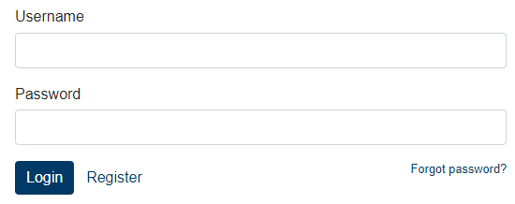
Setting up an account (continued)
Using Google Chrome, Microsoft Edge, Firefox or Safari, navigate to this site in your browser: https://webapp.pca.state.mn.us/services/login
Click Register
Notes:
To set up an account use a compatible web browser to navigate to the link shown on the screen.
Do not yet put any information in the username or password fields. Simply click register (as indicated by the green arrow) to begin the process of establishing your account.

Slide 7
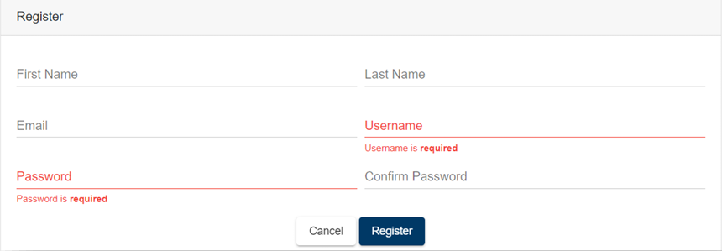
Setting up an account (continued)
Fill out all fields
Click Register
Notes:
Fill out the basic account information form.
You must have a valid email address.
Your password must be between 8 and 40 characters and contain characters from at least two of these groups: lowercase letters, uppercase letters, digits, and special characters. Passwords are case sensitive.
After completing the form click the Register button.

Slide 8
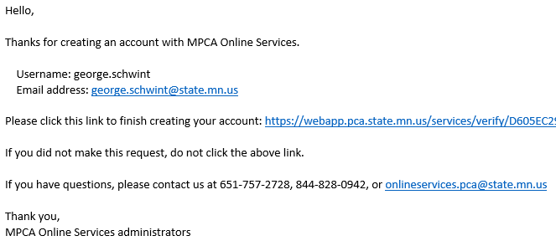
Setting up an account (continued)
You will receive a verification email (example below)
  Click the verification link to complete account setup
Feedlot DEMO
Example
Feedlot.DEMO@email.com
Notes:
After clicking the register button you will receive an email with a link to finish creating your account. You will not be able to login into the service using your newly created username and password until you click the link in the verification email.

Slide 9
Login to e-services
Login using your username and password
  https://webapp.pca.state.mn.us/services/login
Notes:
You will now be able to login to the service by entering your username and password and then clicking the Login button.
In the future, if you forget your password, you can click the forgot password link on this page to re-set your password.

Slide 10
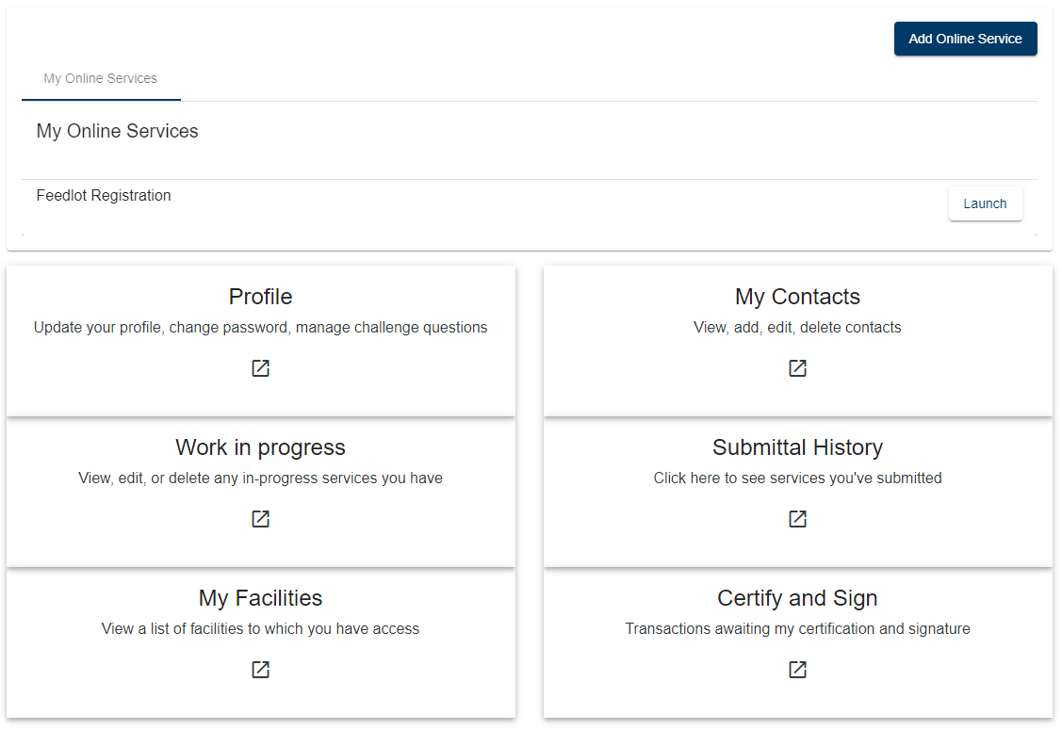
Online services homepage
This page will always be your starting point
  Manage all aspects of your
  permit applications here
  Manage all aspects of your
  e-services account here
  You can access other MPCA
  online services from
  this homepage
    Example: Feedlot Registration
    (which may or may not be displayed
    under My Online Services by default)
More detail on next slide
Notes:
Once you login into the service you will initially be taken to your e-services homepage. This screen is where you manage your account information and access the e-services that the MPCA has to offer for the feedlot program including the online permit application service. As more on-line services are developed, access to them will be via this homepage. For instance you may already see the feedlot registration service as an option to launch from your e-services homepage. Please note that the feedlot registration service is not the same as the feedlot permit application service.

Slide 11
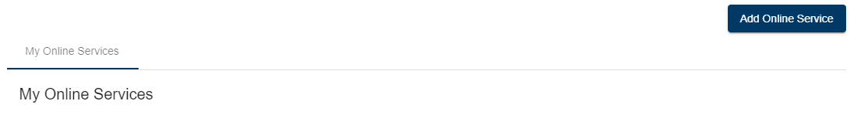
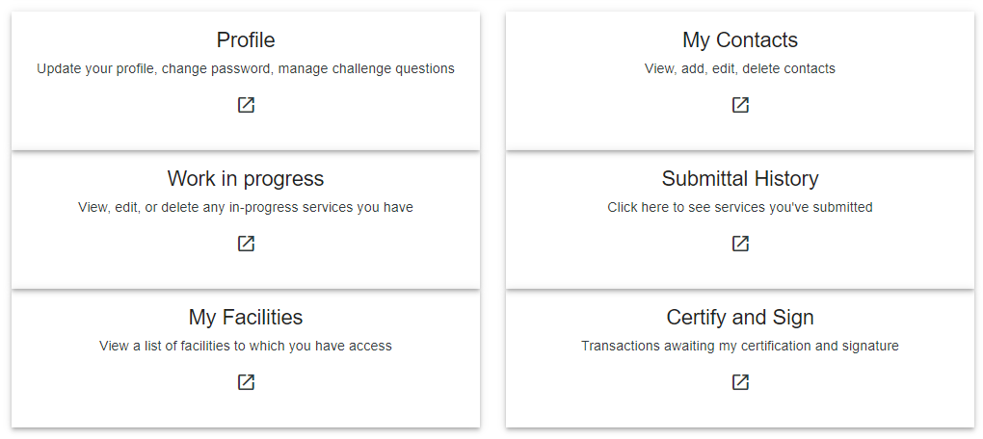
Online services homepage
Click on any area below to learn more
Interactive
Notes:
This is an interactive slide – click on any of the areas below for more information about them or you can simply advance to the next slide and not view any additional information about your e-services homepage.
The online services homepage has two main areas. The top area will list all online services you have requested access to. On this interactive slide click on the “My Online Services” area for instructions on how to gain access to the feedlot permit service.
The bottom area of the online services homepage allows you to manage your account, see your work in progress, see your submittal history, or view a list of facilities you have access to. This is also where you would come to sign an application that was completed by a consultant. Click on any of the buttons on this slide to learn more about these features.

Slide 12
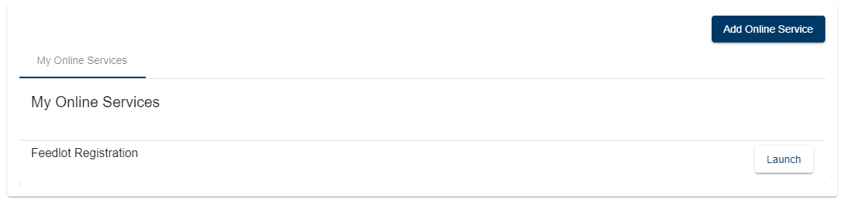
My online services
Lists any type of service you have requested access to
  “Feedlot Registration” may appear by default
    This is NOT used to apply for a feedlot permit
To request access to apply for a Feedlot permit click Add Online Service
Notes:
The My Online Services area of the e-services homepage lists all online services you have requested access to. To request access to the feedlot permitting service click the “add Online Service” button as indicated by the green arrow.
Please note that you may by default see the feedlot registration service in the list of My online services; the feedlot registration service is not the same as the feedlot permit application service.

Slide 13
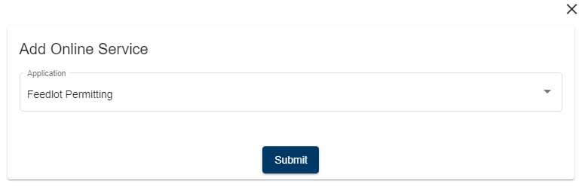
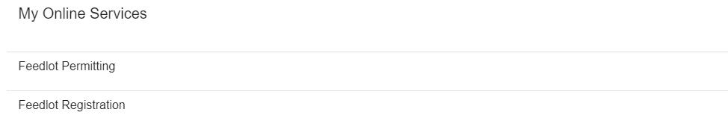
Feedlot permit application service
Select “Feedlot Permitting” and click Submit
  “Feedlot Permitting” is now listed in My Online Services
Notes:
From the list of available services select “feedlot Permitting” and then click the Submit button.
Feedlot permitting will now be listed in the My Online Services area of your e-services homepage.

Slide 14
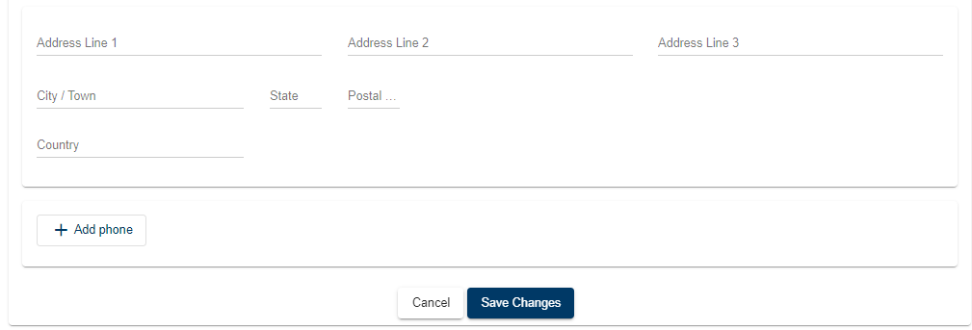
My contact information
Update Name, address, phone, email, etc.
  Click Save Changes at the bottom of the screen to save
Notes:
My Profile allows you to update your account information such as name, address, phone, email, and password.
If needed make any necessary updates to your contact information and click “Save Changes”

Slide 15
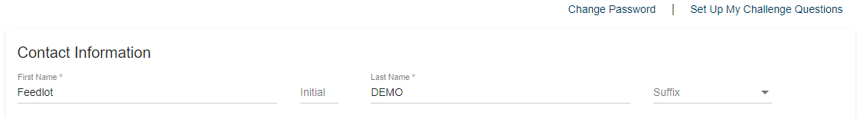
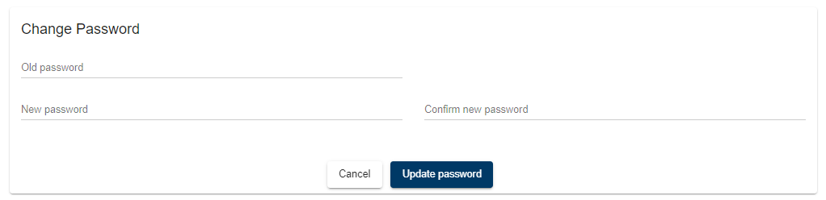
Change account password
Click Change Password at the top of the screen
Make the changes in the window that appears (below)
  Click Update Password to save changes
Notes:
To change your account password click on the change password link at the top right of the My Profile window.
Enter your old password and new password information and then click Update Password to save the changes.

Slide 16
Challenge questions
Challenge questions are used to validate your signature for the permit application
  Click Setup My Challenge Questions
Note: After initial setup this link changes to Manage my Challenge Questions which allows you to change/modify your challenge questions or answers.
Notes:
You will also set up and manage your Challenge Questions via the my Profile button on the e-services homepage. Challenge questions are used to validate the owners signature when submitting a permit application.
To set up or manage your challenge questions click the challenge questions link at the top right of the window, as indicated by the green arrow.

Slide 17
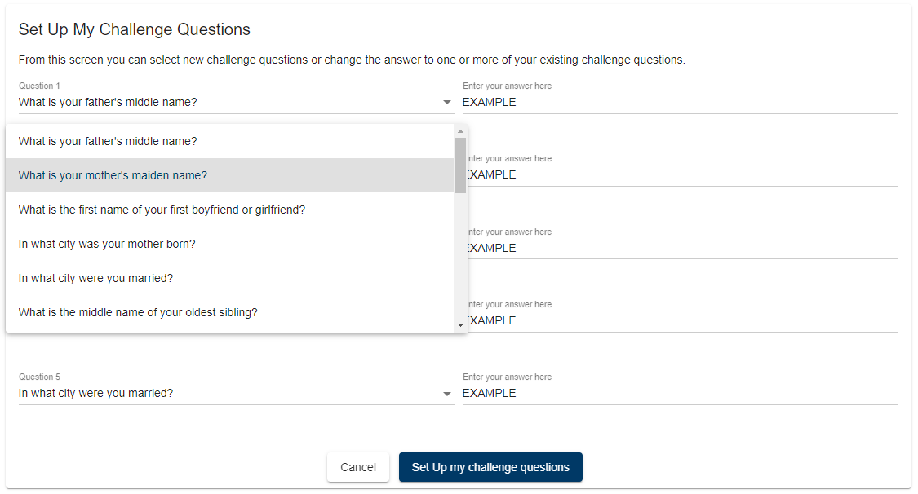
Challenge questions
Select and answer 5 questions
  Then click Set Up my challenge questions
Notes:
You will now need to select 5 questions from the available list and provide an answer.
Toward the end of the online permit application process, you will need to provide an identical answer to the one you provide here in order to verify your signature on a permit application.

Slide 18
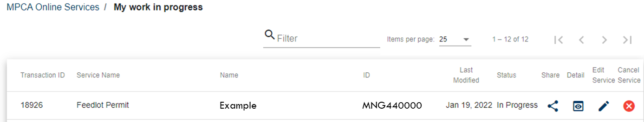
Work in progress
Application status
  In progress
    Application started but not yet submitted
  Awaiting certification
    Consultant has completed application
    preparation – awaiting owner signature
Notes:
A permit application does not need to be completed in one session at the computer. You can start an application, save your work, and come back to it at a later date.
The work in progress button allows you to see the status of your permit application. A status of in progress indicates that the application has been started but has not yet been submitted. A status of awaiting certification means that your consultant has completed their work on the permit application and it is now awaiting your signature.

Slide 19
Accessing saved work
Click to continue working on an application
  You will be taken to the point where you left-off
Click to delete saved work
  You will be asked to confirm this action
    This action cannot be undone
Notes:
To access saved work, which will have the status of “in progress”, click pencil icon. You will then be taken to the point where you last saved your work on the application.
If you no longer need a permit action that you have started you can click the red X to delete that in progress work. This cannot be undone so you will be asked to confirm your desire to delete the information.

Slide 20
Sharing work in progress
Click to share work with another user
  You will need to know their username or
  have them saved as a contact
  They will be notified by email and the application you started will now appear in their Work in Progress list for them to edit
    Example: A consultant completing the application can share the work they have done with the engineer for the project so that the engineer can attach the required plans and specifications to the same application.
Notes:
You can also start an application and share your work with someone else to complete a portion of the application. For instance a consultant can share work that they have started with an engineer to allow them to upload plans and specifications for a new structure at the feedlot. To share work in progress with another user, click the share icon. You will need to know their e-services username in order to share your work with them. They will receive an email notifying them that you have shared an application with them. They can access the shared application from their work in progress list of their e-services homepage. In effect you will both be working on the same application with changes made by either party visible to each person as they are saved.

Slide 21
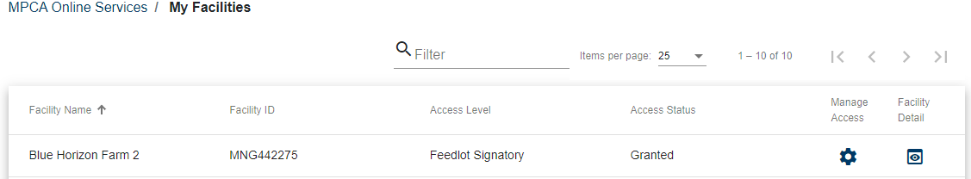
My facilities
Access level
  Feedlot Signatory – Owner
  Feedlot Preparer – Consultant
Mange access
  Signatory can click to …
    See all parties with access
    Approve preparer access requests from consultants
    Remove access from preparers
Example
MNG440000
Notes:
Clicking on My Facilities from your e-services homepage will provide you a list of facilities that you have been granted access to. There are two levels of access in the permit application service. Feedlot signatory which refers to the owner and feedlot preparer which refers to consultants. Details on how to gain access to a facility will be covered later in this tutorial.
Feedlot signatories can click on the manage access icon to control access to their facility, which includes new requests from consultants for access to the facility.

Slide 22
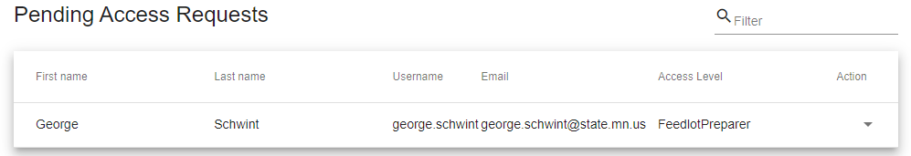
Managing access
Pending Access Requests
  Consultant asking for access to complete an application
    Select approve or deny from action column
  Note: Preparer access can be removed by the signatory by
  clicking in the Approved Users window (not shown)
John
Doe
JDconsulting
JDconsulting@email.com
Notes:
After clicking the manage access icon feedlot signatories will be able to grant, deny, or remove access to feedlot preparers, such as consultants.
To approve a request from a consultant for access to your facility select approve from the action column.

Slide 23
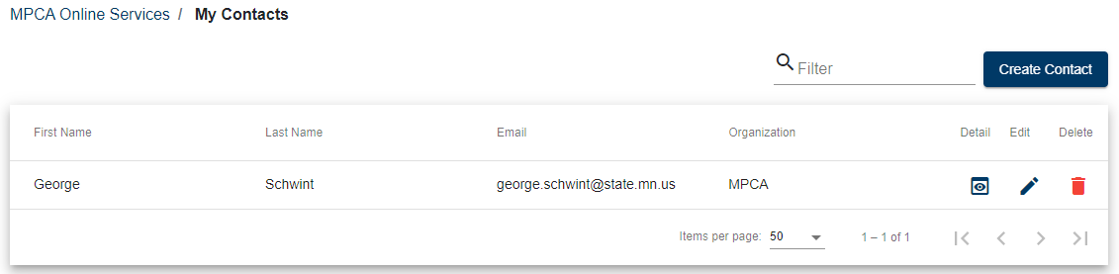
My contacts
Optional “address book” for contacts
  Contact info here can be used to auto-fill application forms
    Click Create Contact to add a new contact
    Click to edit a contact
    Click to delete a contact
John
Doe
JDconsulting@email.com
JD Consulting
Notes:
This is basically an address book for you to store contact information for your feedlot permit application related contacts. Information from your address book can be used to auto-fill information within the permit application service. Click “Create Contact” to add a contact to the list. Use the edit icon and trash can icon to edit or remove people from your contact list as appropriate.

Slide 24
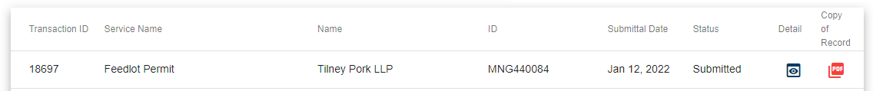
Submittals to the MPCA
Status of the application
  “Processing Payment”
    Displayed until payment is processed
  “Submittal Pending”
    Application is being electronically transmitted to MPCA
  “Submittal failed – contact MPCA”
    Something went wrong call for further instructions
  “Submitted”
    MPCA has received and is processing the application
      Even after permit issuance the status remains “Submitted”
Example
MNG440000
Notes:
Clicking My submittals from the e-services homepage will provide you a list of transactions that you have submitted to the MPCA. You could see any of the following 4 status types.
Processing Payment will be displayed while your method of payment is processed by US bank and as your permit application information is being transferred to the MPCA for review
Submittal pending will be displayed for those applications without a fee to indicate that the permit application information is being transferred to the MPCA for review.
Submittal failed – contact MPCA will be displayed if there was an error with either the payment or transfer of the permit application information to the MPCA. Please call the MPCA for further instructions.
Submitted will be displayed after the MPCA has received the permit application information and any applicable application fee has been transmitted. This status will remain even after the permit has been issued.

Slide 25
What was submitted
Copy of Record
  Summary of all content submitted
    Also sent via email upon submittal
Detail
  Info about when the application was..
    Initially created – and by whom
    Last modified – and by whom
    List of any other user(s) sharing the application
Example
MNG440000
Notes:
To see what was submitted to the MPCA click on the pdf icon to view the copy of record. The copy of record is simply a summary of all the information gathered by the online permit application service. You will have also received this via email.
You can click on the detail icon to view information about the creation, modification, and sharing of the application.

Slide 26
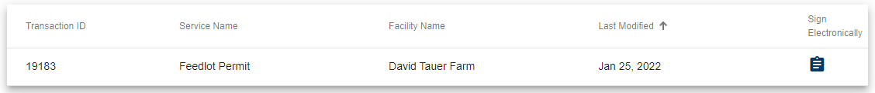
Signing an application completed by a consultant
Feedlot owner ……
Gets email notice that the application is ready to sign
Logs in to their e-services account
Goes to Certify and Sign from homepage
Clicks to begin process to sign the application
Example
Notes:
To sign an application completed by a consultant the feedlot owner will first receive an email notification that an application is ready for them to sign. The owner will then log into their e-services account and navigate to certify and sign on the e-services homepage. There the owner will click on the clipboard icon to begin the application signing process.

Slide 27
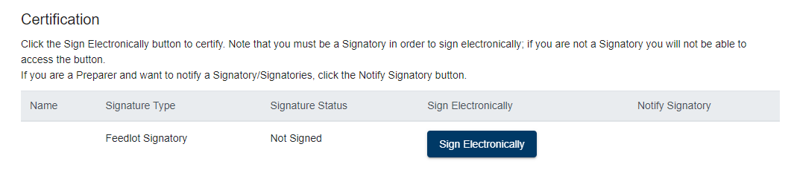
Signing an application completed by a consultant (continued)
Example
Feedlot owner ……
Reads the certification statement
Clicks Sign Electronically
Answers the challenge question displayed (not shown)
Clicks Certify (not shown)
Notes:
To sign the application the owner will need to read the certification statement and click Sign electronically. A challenge questions will be displayed and a correct answer will allow the application to be signed be the feedlot owner.

Slide 28
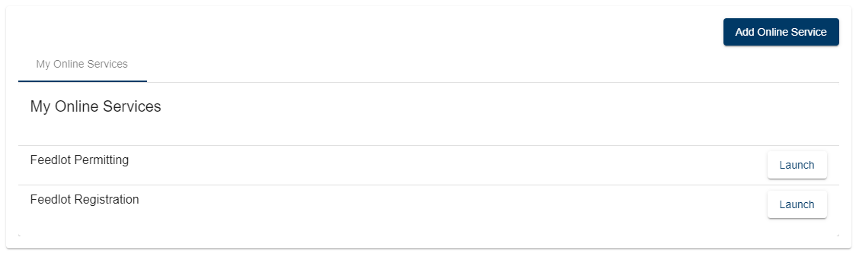
Getting facility access
Click Launch to start the Feedlot Permitting service
  Be sure to launch “Feedlot Permitting”
  if multiple services are listed
Don’t see “Feedlot Permitting”?
Click here for instructions
on how to add it.
Notes:
To start a feedlot permit application for a facility you must first obtain access to the facility. From the My Online Service area of the e-services homepage click the Launch button for the Feedlot Permitting service to get started.

Slide 29
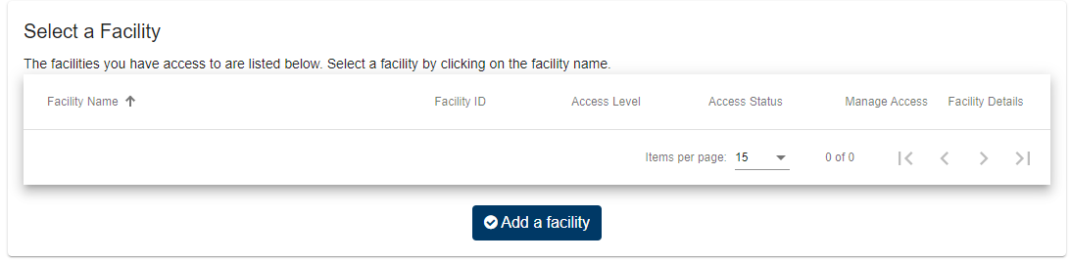
Choose your facility
Click Add a facility
Notes:
To gain access to a facility you will first need to click the Add a Facility button. Once you gain access to a facility its name will appear on this page.

Slide 30
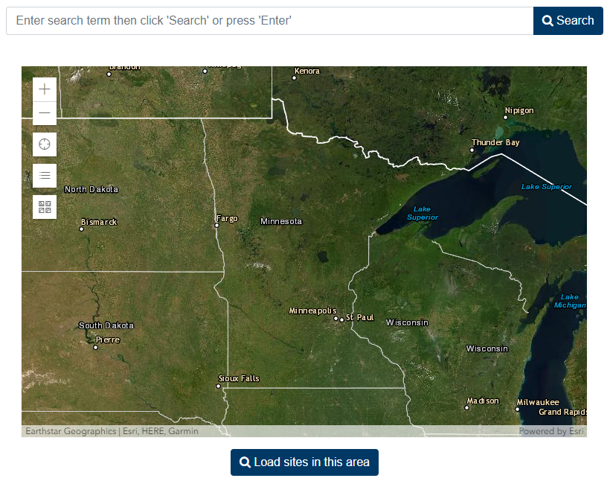
Search for your facility click on an area below to learn how to use each search type
Interactive
Got a new facility?
Use a map search
to get started
Notes:
There are two ways to search for your facility.
Click on the search bar or map area on this interactive slide to learn more about either search option.
If you have a new site use the map search to get started.

Slide 31
Using the search bar
Type any of the following into the search bar
  Facility or owner name
  Facility address
  Feedlot registration number
  Permit number
Selectable results appear as you type
After entering some info click Search
Notes:
The search bar is used to find existing facilities by facility name, owner name, facility address, feedlot registration number, or feedlot permit number. As you being to type, potential matching information will appear below the search bar, you can click on the matching information to auto-fill the search bar.
After entering the search information click the Search button.

Slide 32
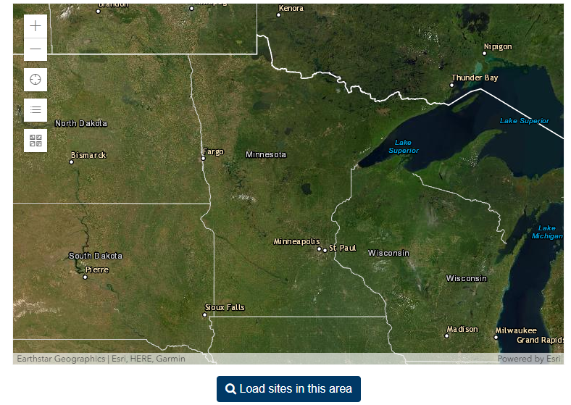
Using the map to search
Zoom In
Zoom into the
general area of
the feedlot
  Use the plus sign
  to zoom in
  As you zoom, move
  the map by clicking
  and dragging
After zooming in
Click Load sites in this area
Zoom Out
Notes:
Using the plus sign begin zooming into the general area where your feedlot is located. Move the map North, South, East, or West by clicking and dragging the map. Be sure to zoom in a fair amount to minimize the resulting list of potential matches for your site.
After zooming into the general area click the Load Sites in This Area button.

Slide 33
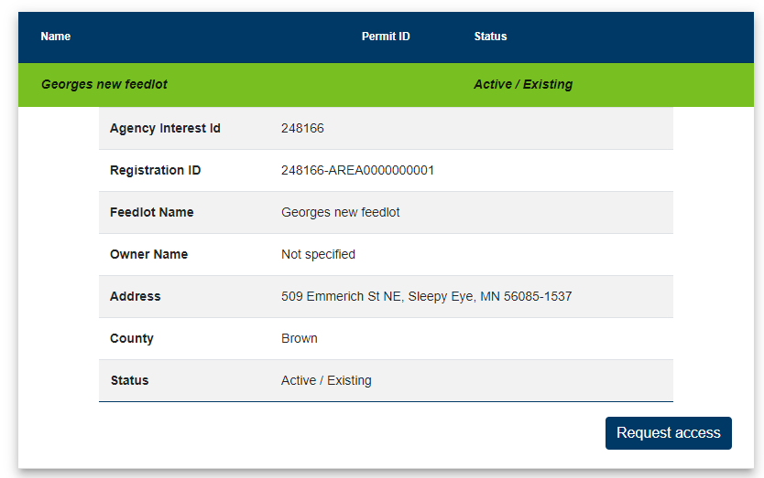
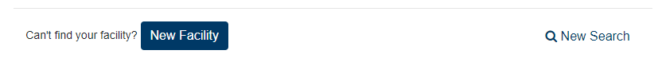
Search results
Scroll down to the bottom of the page
Click the appropriate facility name and click Request access
  Can’t find your facility or have a new facility?
  Click “New Facility” at the very bottom of the page
Can’t find a facility
you know exists?
Try a map search.
Tip
Example Farm
Example Farm
Street, City, State, Zip
Notes:
The search results of either the search method are displayed below the map. Click on the name of the facility you were searching for and then click request access.
For new facilities, click on the New facility button to input information about its proposed location.
If you can’t find your facility after using the search bar, try a map search before clicking the New facility button.

Slide 34
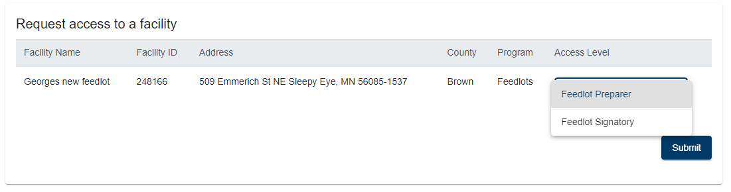
Select a facility access level
Feedlot Signatory (owner)
  Click Next
Feedlot Preparer (consultant)
  Click Submit
  Note: Facility must have a feedlot signatory before preparer access can be granted
Click here for more info about facility access levels
Notes:
After clicking request access you will need to identify which type of facility access you desire. Feedlot owners should select feedlot signatory while all others should select feedlot preparer. Please be aware that feedlot signatory account access must be established before feedlot preparer access can be granted. Only the feedlot signatory can grant preparer access to the facility.
After selecting the level of access you desire, click the Next or Submit button.

Slide 35
Types of facility access
Feedlot Signatory
Feedlot Preparer
A person with the legal authority to sign the permit application.
(owner, managing partner, etc.)
A person who can complete one or more components of the application, but is not legally authorized to sign the application.
(consultant, engineer, etc.)
Feedlot signatory access needed before preparer access can be granted
Notes:
The feedlot signatory designation is used to identify the owner or member of the ownership group that would have legal authority to sign the permit application.
The feedlot preparer designation is used to identify people that the owner desires to grant access to in order to complete one or more components of the feedlot application. Only feedlot signatories can grant preparer access therefore the first step to completing a permit via the online service is to establish a feedlot signatory account.

Slide 36
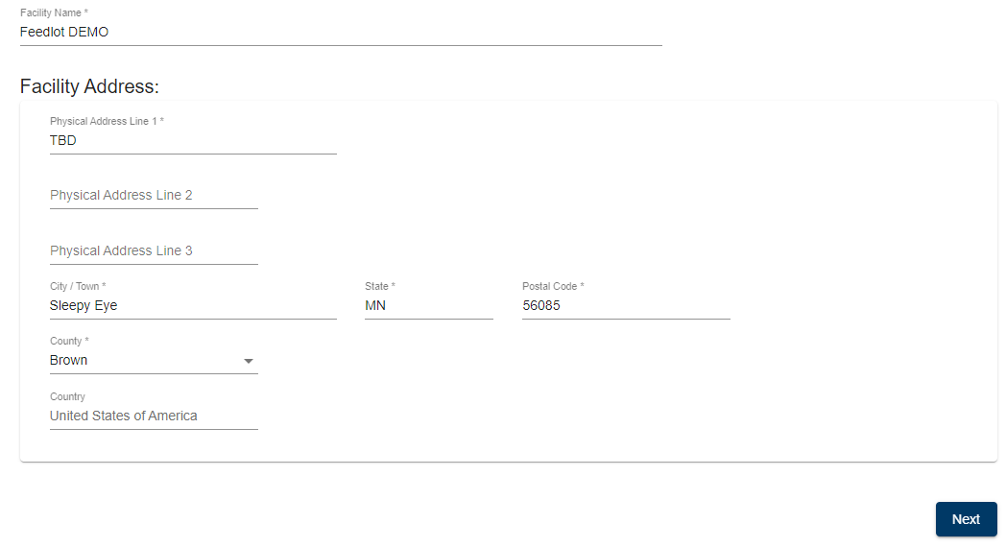
New facility location
Only required for new facilities
Complete the facility location form
  If street address is unknown – enter TBD
  Click Next
Notes:
Only new facilities will be asked information about the location of their proposed feedlot. The MPCA already has location information for existing sites so there is no need to ask for that info again. Complete the form and click Next.
If you do not yet have a 911 address for the site enter TBD for the address.

Slide 37
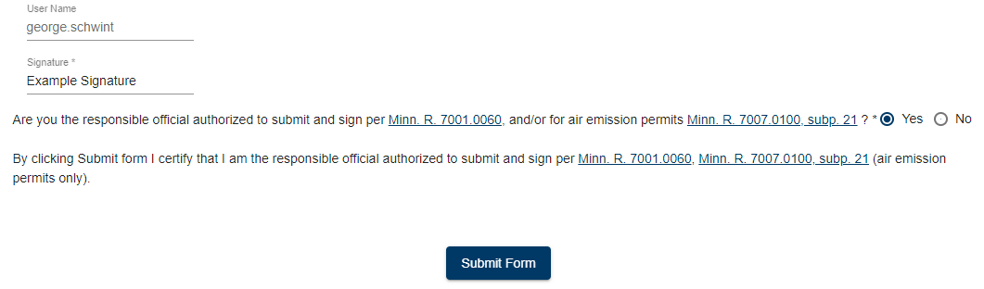
Feedlot signatory certification
Only required for feedlot signatory requests
Complete the contact information at the top of the form
Common missed info: Title (upper right of form)
Type your name as your “signature”
Affirm you are authorized to sign the application
Click Submit Form
Example
Notes:
Feedlot signatory requests will need to complete the contact information at the top of the feedlot signatory request form. Be sure to enter a title at the upper right of the form as it is required but is commonly missed.
Then type your name in the blank indicated by the green arrow and answer the yes/no question presented.
Finally, click Submit Form to affirm that you are authorized to sign the permit application as outlined in Minn Rule 7001.0060. and are requesting signatory access to this facility.

Slide 38
Approval of facility access
Feedlot Signatory
Feedlot Preparer
MPCA reviews request
Email confirmation of MPCA approval
  Can take up to
  3 business days
Feedlot owner notified by email of request
  Feedlot owner approves/denies
Email confirmation of owner approval
Tip
Request signatory access early in your application process to avoid a delay
Notes:
Upon receiving a feedlot signatory request MPCA staff review the information and formally approve the request within 3 business days. Do not expect to request and gain feedlot signatory access the same day you or your consultant plan to begin entering more detailed information about your facility.
Getting feedlot preparer access can happen quicker as it is controlled entirely by the feedlot signatory. MPCA approval is not needed for feedlot preparer requests.

Slide 39
Starting a permit application
Click Launch to start the Feedlot Permitting service
  Be sure to launch “Feedlot Permitting”
  if multiple services are listed
Don’t see “Feedlot Permitting”?
Click here for instructions
on how to add it.
Notes:
To start a feedlot permit application click on the “Launch” button for the Feedlot Permitting service, as indicated by the green arrow. If you do not see the launch button, click on the cloud icon for further instructions.

Slide 40
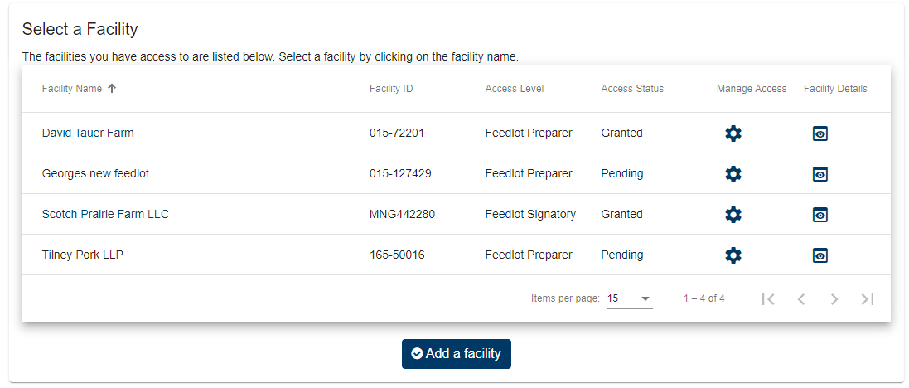
Select your facility
Click on the name of the facility
Don’t see any facilities?
Click here for instructions
on how to get access to one.
Example Farm 1
Example Farm 2
Example Farm 3
Example Farm 4
Notes:
From the list of facilities that you have access to, click on the name of the facility to start a permit application.

Slide 41
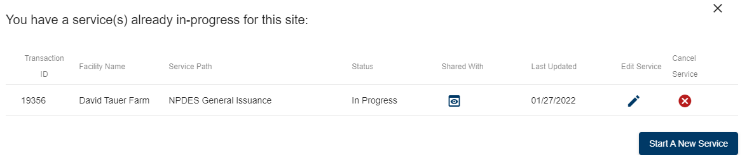
Already in-progress
If an application is already started you will see the window below. You can……
  Continue where you left off by clicking
  Delete the application by clicking
  Start another application by clicking Start a New Service
Example Farm 1
Note: If you are editing an existing application, you may not see some of the screens that follow in this guidance.
Notes:
If you have already started an application for the facility, the service will ask you if you want to continue working on that application, or, if you would like to start a new application. To continue working on the application you already started, click the pencil icon. If you want to start a new application, click the “start a new service” button.

Slide 42
Permit application selection guide
Interactive guide to determine the type of permit you need
  Hyperlinks are provided in the guide for help with questions
Answer the yes/no questions to start the process
  Facilities with existing permits first asked…
    Do you need to modify your existing permit
    Is your permit expiring and you need to reapply for permit coverage
  Do you need/want a NPDES permit
  Do you need/want a SDS permit
  Do you need an Interim permit to correct a pollution hazard
  Do you need a CSF permit for construction of 300 or more AU
When enough questions are answered the service will tell you what type of permit you will be applying for
  Click Continue to start that type of permit application
Notes:
The first thing the service will do is ensure that you are applying for the correct type of permit. The online service knows if your feedlot has a permit and will ask if you want to modify that permit. If you do not have a permit you will not be asked this question.
Answer the yes/no questions that appear. If you need more information about a question, such as; “what are the large CAFO thresholds?”, click on the hyperlinks provided in the service.
When enough questions have been answered the service will inform you of the appropriate type of permit within a pop-up window. Click Continue in the pop-up window to proceed with the application for that type of permit.

Slide 43
Permit application process
Interactive
Click a button below to learn how to use the online service to apply for that type of permit.
NPDES permits
(General or Individual)
SDS permits
(General or Individual)
CSF permits
Interim permits
Notes:
On this interactive slide choose the type of permit that you are applying for. If you do not make a choice on this slide and simply advance to the next slide the tutorial will end.

Slide 44
Permitting Table of Contents
NPDES and SDS permits
Interactive
Click the blue home icon on any permitting slide to return to this Table of Contents
Click on any topic below for more info
Navigating the service
Application readiness
Facility general info
  Name & location
  Contacts
  Prevention opportunities
Facility components information
  Animal holding areas
  Manure storage and
  treatment areas
  Feed storage areas
  Mortality management areas
Air emissions plan
Sensitive areas
Environmental review
Facility monitoring
Manure management
Attachments
Signing and submitting the application
  Summary
  Certification
  Payment of fees
Application processing
Click here to see info on all topics in one continuous slide show.
Notes:
This interactive slide contains a table of contents for the NPDES and SDS permit pathways. Choose a particular topic that you need help with by clicking on the orange hyperlink text. After viewing information on that topic you will be returned to this slide to select another topic. If you would like to view all topics as one continuous slide show simply click on the cloud icon.
If at anytime you want to return to this slide you can click on the blue home icon in the upper right hand corner of any slide.
If you do not make a choice on this slide and simply advance to the next slide the tutorial will end.

Slide 45
Permitting Table of Contents
CSF and Interim permits
Interactive
Click the blue home icon on any permitting slide to return to this Table of Contents
Click on any topic below for more info
Navigating the service
Application readiness
Facility general info
  Name & location
  Contacts
  Prevention opportunities
Facility components information
  Animal holding areas
  Manure storage and
  treatment areas
Sensitive areas
Environmental review
Manure management
Attachments
Signing and submitting the application
  Summary
  Certification
Application processing
Click here to see info on all topics in one continuous slide show.
Notes:
This interactive slide contains a table of contents for the CSF and Interim permit pathways. Choose a particular topic that you need help with by clicking on the orange hyperlink text. After viewing information on that topic you will be returned to this slide to select another topic. If you would like to view all topics as one continuous slide show simply click on the cloud icon.
If at anytime you want to return to this slide you can click on the blue home icon in the upper right hand corner of any slide.
If you do not make a choice on this slide and simply advance to the next slide the tutorial will end.

Slide 46
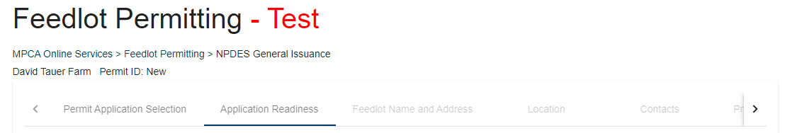
Navigation
The permit application is broken into sections displayed as tabs at the top of the screen
Example Farm 1 Permit ID: New
  The section you are in is noted by an underline
  You need to complete the tabs in order
    Unavailable sections have faint gray tab text
You can come back later to edit a completed section
Notes:
The online service breaks down the application into a number of parts as represented by the tabs displayed across the top of the screen. The number and content of the tabs varies by the type of permit you are applying for. The section that you are currently working on is denoted by an underline. You must complete the tabs in order. As an example you cannot enter location information without first entering facility name and address information. You can return to previously completed sections of a permit application if you need to edit or add information.

Slide 47

Navigation (continued)
Save and Next buttons at the bottom of the screen
  Save – saves the work on the page
  Next – saves the work and advances to the next section
    When required fields are missing
    the button is gray (not active)
    When all required fields are complete
    it turns blue (active)
    Required fields are marked with an *
Notes:
Each section of the permit have a save and next button at the bottom of the screen. The save button is used to save any information on the page. The next button saves your work on the page and advances you to the next section of the permit application.
You will not be able to advance to the next section of the permit until you have completed all necessary data entry on the section you are working on. Required fields are marked with an asterisks and the next button will stay gray until all required information has been entered. When the next button turns blue you can advance to the next section of the permit.

Slide 48
Helpful tips
Hovering your cursor over data entry fields and drop down lists reveals help text (when available)
Hover over any info icons for more info
Required fields are marked with an *
The pencil icon is clicked to edit information
The trash can icon is clicked to delete information
Notes:
The service is equipped with help text to assist you in completing your permit application. Some of the data entry fields and drop down lists have help text that displays as your cursor hovers over the data entry field or list choice. There are also information icons that provide help text simply by hovering over the information icon.
All required data entry fields are marked with an asterisks.
The pencil icon is displayed when there is an opportunity to edit existing information.
The trash can icon is displayed to allow deletion of information you entered into the service in your current session.

Slide 49

Pre-populated information
If the facility has/had a permit with the MPCA some application information will be pre-populated
  Always review this information
  Correct any mistakes
  Update with new info where necessary
  Change something you didn’t mean to
    Original existing info displayed below data entry blank
Notes:
If you currently have or have had a permit issued by the MPCA in the recent past the online service will display the information it has in its database about your facility. Always review this information and make changes where necessary. If you accidently change something and want undo your change, simply re-enter the original information which is displayed below the data entry field for convenience. No information is changed within the MPCA database until you formally submit this application.

Slide 50
Application readiness
Informs you of supporting documents that are or may be required to complete your application
  Answer some yes/no questions to determine what supporting documents are required
    All required documents must be included before
    application submittal is allowed – such as…
      Manure Management Plan (MMP)
        with field maps (if required)
      If required – Construction plans and specifications
      If required – Good neighbor notice
  Read the acknowledgements
    You are agreeing to these items with this permit application
  Be ready to pay applicable permit application fees
Notes:
Some pieces of a permit application are completed outside of the online service and then uploaded to the service to be included with the application; such as, the manure management plan. The application readiness screen alerts you to all the additional pieces of information that may be required before you can formally submit your application. Answer the yes/no questions on the screen to determine which additional documents are required and which ones are optional.
You can continue working on your permit application without all the required documents; but they will be required before the application can be formally submitted.
Also, you will need to be ready to pay the applicable permit fees, before the application can be submitted.

Slide 51
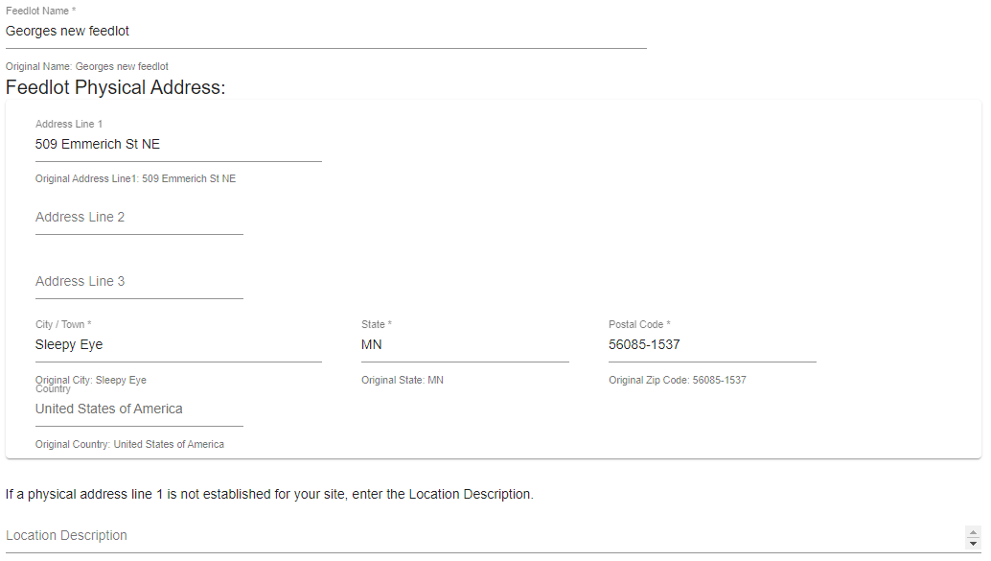
Feedlot name and address
Feedlot physical address
Example Farm
Example Farm
The actual address of the physical facility
Street address
Street address
No address yet?
Enter a location description (below)
Ex: TBD 260th Ave - ½ mile N of 350th St
Notes:
Enter the name of the feedlot and the physical address on this screen.
IF you are a new feedlot and have not yet been given a 911 address, complete as much of the form as you can and use TBD for the number portion of the street address. New facilities without an address should also provide a location description as indicated on this slide.

Slide 52
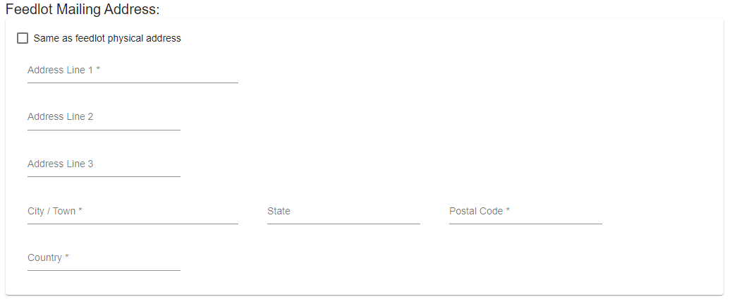
Feedlot name and address
Feedlot mailing address
Clicking this box auto-fills address info from the top of the screen
Where mail for the feedlot should be sent
Notes:
Enter the address where you would like mail for the facility sent to.
If it is the same as the physical address check the box at the top of the data entry grid.

Slide 53
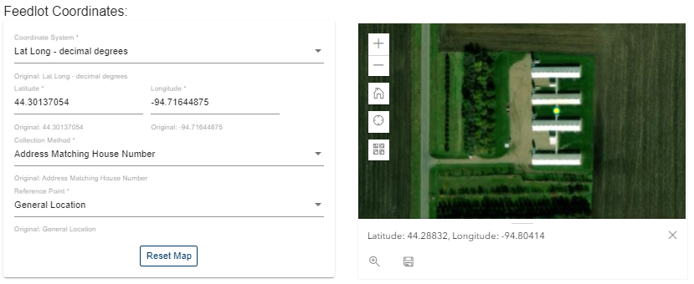
Location
Mapping the feedlot location
Use the Map to Locate Your Feedlot
  Zoom in or out and drag across the map to locate your site.
  Click a point in the center of your feedlot.
  When a dot appears, click on the save icon below the map.
You do not need to do anything with the feedlot coordinates info
Notes:
You will need to map the overall location of your feedlot. Even existing feedlots will need to update the mapped location of their feedlot the first time you apply for a permit via the online service.
Using the map tool zoom and drag the map until you see your facility on the screen. Then simply click a point in the center of your facility. Click the save icon below the map to save the updated point on the map.
You can ignore the feedlot coordinates data displayed, it is automatically updated when you click save to update the dot on the map.

Slide 54
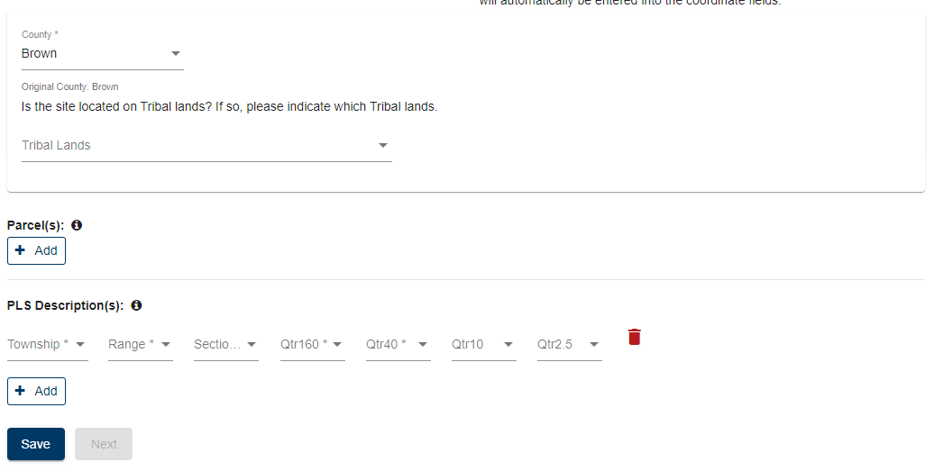
Location
Other locational information
In the service,
hover your mouse
over this icon
to get more info.
Tip
Optional
Feedlot located in multiple Qtr40’s?
Click here for additional lines for PLS description
Notes:
You will need to enter the county in which the facility is located.
If the facility is located in tribal lands please indicate which tribal lands via the drop-down menu.
There is also an opportunity for you to enter parcel information. This is optional information.
Finally add a public land survey description down to the quarter quarter. If you need to add another line for more PLS quarter quarters click the add button to add as many lines as you need.

Slide 55
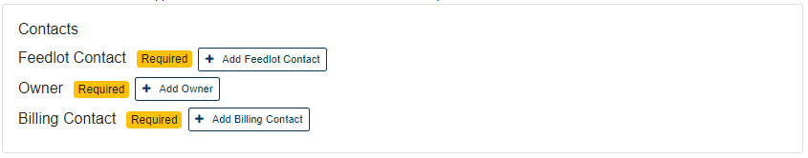
Contacts
Types of required contacts
Feedlot Contact
  The person that handles day-to-day operations
    Who to contact to set up facility inspections
    Can have multiple contacts listed
Owner
  The legal owner(s) of the facility
    All owners of partnerships must be listed
Billing Contact
  Where annual permit fee invoices should be sent
    Only one contact allowed
In the service,
click this icon
to edit existing data
Tip
Click the appropriate “Add” button to begin data entry
Notes:
The contacts screen gathers information about three types of contact people for the feedlot. They can all be the same person or may be different people.
The feedlot contact is the person that handles the day to day operations. It is someone that the MPCA can contact to set up a site inspection or call for specific questions about the operation of the feedlot. You must have at least one contact listed here.
The owner contact is where all owners of the facility should be listed. If the feedlot is owned jointly by a husband and wife or father and son then both need to be listed as owners. If the feedlot is owned by a partnership, all members of the partnership need to be listed as owners. You must have at least one contact listed here.
The billing contact is where the annual permit fee invoice should be sent each year. You must have only one contact listed here.

Slide 56
Contacts
Types of required contacts
Feedlot Contact
  The person that handles day-to-day operations
    Who to contact to set up facility inspections
    Can have multiple contacts listed
Owner
  The legal owner(s) of the facility
    All owners of partnerships must be listed
In the service,
click this icon
to edit existing data
Tip
Click the appropriate “Add” button to begin data entry
Notes:
The contacts screen gathers information about two types of contact people for the feedlot. They can both be the same person or may be different people.
The feedlot contact is the person that handles the day to day operations. It is someone that the MPCA can contact to set up a site inspection or call for specific questions about the operation of the feedlot. You must have at least one contact listed here.
The owner contact is where all owners of the facility should be listed. If the feedlot is owned jointly by a husband and wife or father and son then both need to be listed as owners. If the feedlot is owned by a partnership, all members of the partnership need to be listed as owners. You must have at least one contact listed here.

Slide 57
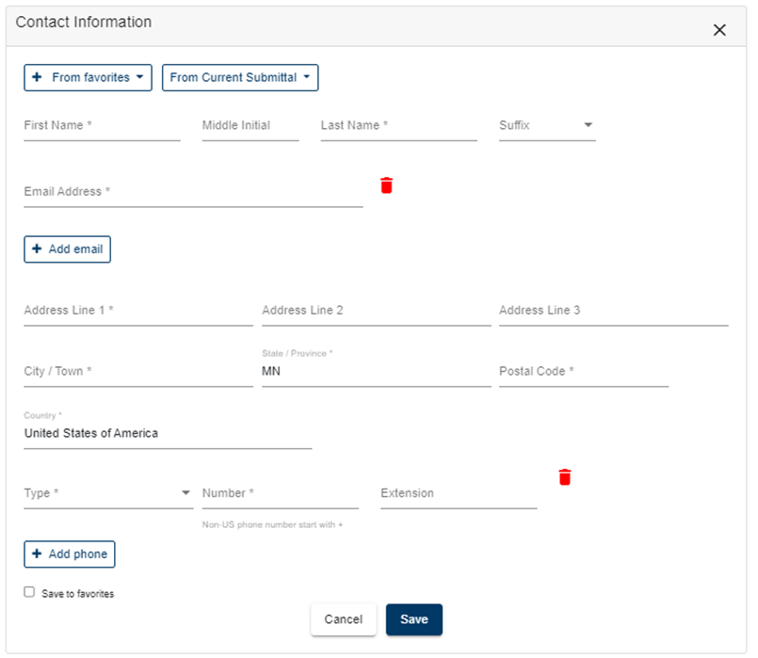
Contacts
Data entry screen
Click here to auto-enter any contact info saved to your “favorites”
Click here to auto-enter any contact info not saved to your “favorites” but used elsewhere in this application
Click here to add more than one email address
Click here to add more than one phone number
Check this box to save above info to “favorites” to speed future data entry
Notes:
The data entry screen for the contact information is pretty straightforward. The two button at the top of the screen can be used to auto-fill this form with contact information saved to your favorites or information used in a different type of contact in this submittal.
To save a contact to your favorites simply check the box at the bottom of the window and click Save.

Slide 58
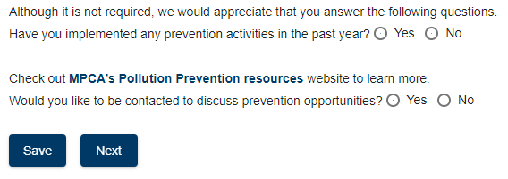
Prevention opportunities
Entire screen is optional
A way to know the good things that are happening even though a permit wasn’t needed for the work
A chance for those that want more info on pollution prevention to get in touch with MPCA staff
Answering the questions is optional
Notes:
The prevention opportunities screen is a totally optional screen . You do not have to fill out any of the information on this screen.
This screen is a chance for the MPCA to know about the other pollution prevention measures you have done this past year that are not directly related to feedlots. One example is the installation of grassed waterways in your land application fields.
There is also an opportunity for you to get more info about possible pollution prevention opportunities from the MPCA.

Slide 59

Animal holding & numbers
Answer the pasture question at the top of the screen
Answer the animal holding question at the top of the screen
  Existing sites with animal holding areas will not see a question
  Animal holding areas include
    Total confinement barns
      Total confinement barns with underfloor manure storage are managed separately from other total confinement barns in the service
        Includes pull plugs, free-stall barns with day pit under the barn, etc.
    Partial confinement barns
    Open lots
    Calf huts/hutches
Enter each animal holding area separately
Click the button to add more structures
Notes:
On the animal holding and numbers screen you will need to answer the pasture access question at the top of the screen.
New sites will need to indicate if their feedlot will have animal holding areas, while existing sites will not be asked this question.
Animal holding areas include total confinement barns, partial confinement barns, open lots, and calf huts or hutches. Animal holding areas do not include pastures.
You will need to enter information about your animal holding areas one at a time. You can add as many animal holding areas as you need by using the add button.

Slide 60
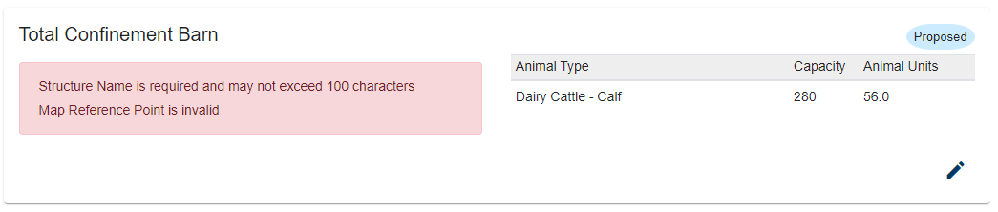
Animal holding & numbers
Sites with existing information
Initially, every existing animal holding area will need to be edited
  Click the edit button
    Add a structure name and update map location
  For animal holding areas with status of “Proposed”,
  edit the status to …
    Active - construction completed
    Under Construction - actively being built or
    still planned but construction not yet started
errors or missing info is identified in the pink box
Notes:
If you are an existing site with pre-populated information, you will need to update some information for every animal holding area. You will need to at least add a structure name and update the map location by clicking the pencil icon to add or edit the data.
You should also click the edit button to view and verify that the pre-populated information is correct. If not, you will need to update the information.
If your previous permit authorized construction of a new animal holding area, it will have a status of “proposed”. You will need to change that status of any proposed structure no matter if it has been built, is currently being built, or has not yet been built.
If the construction of the proposed structure has been completed you need to edit the status of that animal holding area to “active” to indicate that construction has been completed. If construction has not yet started, or is in process, use the status of “under construction”.

Slide 61
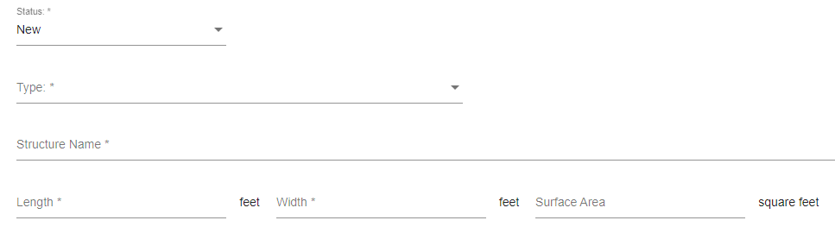
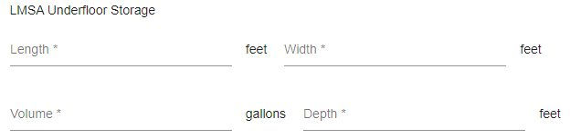
Animal holding & numbers
Physical characteristics of each animal holding area
Interactive
Click any data entry field for answers to frequently asked questions
  Click the data entry field a second time to hide the info
Type
Q: I have shallow pull plugs under my barn floor is that a
total confinement barn with underfloor storage
A: Yes, any structure with a pit of any size under the barn is a
total confinement barn with underfloor storage.
Q: I have a small day pit under my free-stall barn, is that a
total confinement barn with underfloor storage
A: Yes, any structure with a pit of any size under the barn is a
total confinement barn with underfloor storage.
Q: How do I list my calf huts
A: Select a type of: individual animal holding areas.
    A quantity field will become available after selecting this holding area type.
Q: The type of my existing structure is wrong, how do I change it
A: 1) Change the status to: To Be Eliminated
2) Add a different structure of the correct type with the status: Active
Status
Q: I am adding on to a barn, how do I enter that into the service
A: If the addition plus existing barn will managed as one large barn…
    Change the status of the existing barn to Proposed and indicate the new overall
    (barn + addition) dimensions.
If the addition is managed as a “separate” barn …
    List the addition as a New barn.
Q: I have a barn that was permitted but I have not yet started construction, what should I select for status
A: List this barn as Under Construction.
Q: I have closed a barn, what should I select for status
A: List this barn as To Be Eliminated (even though it has already been closed).
For existing facilities that recently completed construction, be sure to change the status of the completed structures from Proposed to Active.
Structure Name
Enter the common name for the animal holding area
It must be unique from other structures at the facility
Example: Heifer Barn, Gilt Isolation, Brood Barn, etc.
Length, Width, & Surface Area
Q: I have an irregular shaped structure how do I enter the information
A: Enter the largest length and width in feet and list the surface area in square feet
Underfloor Storage Information
Q: My pit has multiple depths, what should I do
A: Enter the maximum depth
Q: What volume should I use
A: Enter the permanent storage volume – overall volume minus freeboard
(8ft deep swine barns typically have a permanent storage depth of 6.5 – 7 ft)
Questions about pull-plug barns, calf huts,
barn additions, odd-shaped structures, etc.?
Click on the data entry fields for more info
This is only visible for holding area type:
Total confinement with underfloor storage
Notes:
On this interactive slide, click on any data entry field to see answers to frequently asked questions about the data that needs to be entered for each animal holding area.
The online service also has help text available by hovering over the drop down list choices for status and type.
Be sure to select the structure type of “Total Confinement with Underfloor Liquid Storage” if your total confinement barn has a deep pit, shallow pit, day pit, or other liquid storage area directly under the barn. Information about the under floor liquid storage area is also gathered on this page, as indicated by the dashed rectangle.
Calf huts or hutches will use the type of “Individual animal housing area”. You will need to indicate the dimensions of one of the calf huts and then indicate the how many of those same size calf huts you have. For example, a facility with 10, 7 ft diameter calf huts, would not list 10 different animal holding areas but rather one individual animal housing area with a quantity of 10.
Finally if you are going to be adding onto an existing animal holding area – use the interactive slide and click on the status data field for more information on how to enter that addition into the online service.

Slide 62
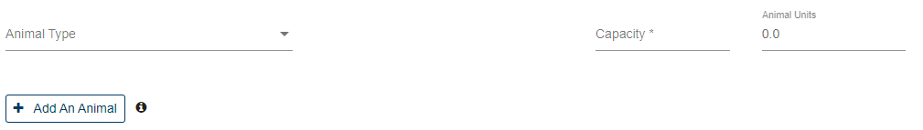
Adding animals to animal holding areas
Every animal holding area must have at least one animal housed within it, except…..
  Open lot with access to a partial confinement barn
    Animals should be listed with the barn, none in the associated open lot
  Milk Parlor-Holding Area (temporary holding)
  Working-Sorting-Hospital Area (temporary holding)
  Any holding area with status To Be Eliminated
Must use animal holding capacity of the structure
  Most that could physically be placed in the animal holding area
    Not intended stocking numbers or numbers after death loss
    All stalls full, all crates full, all pens full, etc.
Click here to add more than one animal type to the holding area
Eliminating the animal holding area?
Enter 0 (zero) for capacity
Notes:
Indicate the animal holding capacity of each animal holding area. The number of animals should reflect the most that could physically be placed in the animal holding area, not the intended stocking density. For example, if your swine barn has 200 farrowing crates then the capacity of that barn is 200 pigs, even if you always have a some empty crates as your normal operating procedure. Likewise, do not account for mortality rates in poultry barns. If your poultry barn initially has 20,000 birds the capacity of that barn is 20,000 birds, not the number of birds that leave the barn.
For partial confinement barns with open lots, the animal capacity of the partial confinement barn should reflect the cumulative number of animals housed within the partial confinement barn and associated open lot. The open lot must still be listed as a separate animal holding area but should have no animals associated with it.
If you are eliminating an animal holding area, enter zero for an animal holding capacity. You cannot delete the animal data entry fields

Slide 63
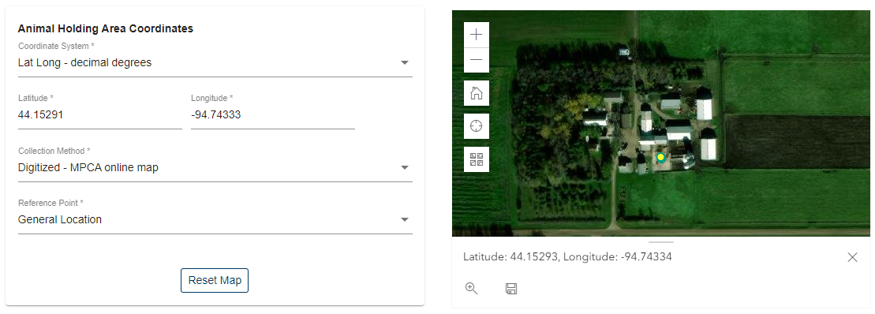
Mapping the animal holding area
Use the Map to identify the location of each animal holding area
  Zoom in or out and drag across the map to locate the holding area.
  Click a point in the center of the holding area.
  When a dot appears, click on the save icon below the map.
You do not need to do anything with the coordinates box
Notes:
You will need to map the location of each animal holding area. Even existing feedlots will need to update the mapped location of their animal holding areas the first time you apply for a permit via the online service.
Using the map tool, zoom and drag the map until you see your facility on the screen. Then simply click a point in the center of the animal holding area. For new animal holding areas indicate the approximate location on the map. Click the save icon below the map to save the updated point on the map.
You can ignore the feedlot coordinates data displayed, it is automatically updated when you click save to update the dot on the map.

Slide 64
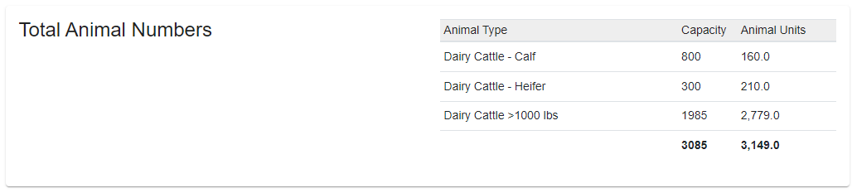
Total animal numbers
A summary of all animals at the facility
  To change it, go back and edit animal numbers in the holding areas
Notes:
A summary of all animals at the facility is provided towards the bottom of the animal holding and numbers screen. This is a summary only and cannot be edited.

Slide 65
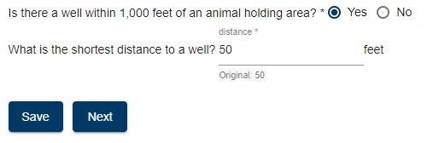
Well proximity
After entering all animal holding area info
  Scroll to the very bottom of the screen
  Answer the well proximity question
    If a well is within 1,000 feet of any holding area
      Enter the shortest distance to the well from the holding area
Notes:
At the very bottom of the animal holding and numbers screen you will need to answer questions about well proximity. If a well is within 1,000 ft of any animal holding area indicate the shortest distance from any animal holding area to that well.

Slide 66
Manure storage
Answer the manure storage question at the top of the screen
  Existing sites with manure storage areas will not see a question
  Manure storage or treatment areas include
    Liquid Manure Storage Areas (LMSA) - various types
      Any structure with manure that is less than 15% solids or non-stackable (3:1)
        Basins, pits, lagoons, wedge pits, sand lanes, reception pits, day pits,
        many stacking slabs, many settling basins, etc.
    Permanent Manure Stockpile
    Infiltration Basin-VTA
    Filter-buffer strip
Enter each manure storage or treatment area separately
Click the button to add more structures
Notes:
Unless your are an existing site with a manure storage or treatment area, you will first need to indicate if your feedlot will have manure storage or treatment area.
Manure storage and treatment areas include all types of liquid manure storage areas, permanent manure stockpiles, vegetative infiltration basins, and vegetative filter or buffer strips. Short-term manure stockpiles should not be included.
You will need to enter information about your manure storage areas one at a time. You can add as many manure storage areas as you need by using the add button.

Slide 67
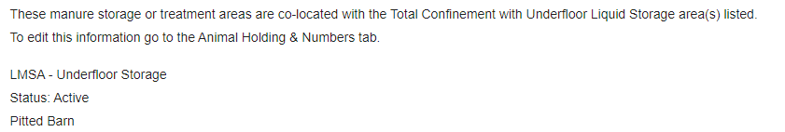
Manure storage
LMSAs under total confinement barns
LMSAs under total confinement barns
  Do NOT enter any information on the manure storage screen
  LMSA info was already entered with the barn information
    You will see a summary of the manure storage information at the very top of the page
Tip
A swine site which only
has underfloor manure storage would not enter
any information on the
manure storage tab
Notes:
You do not enter any information about the liquid manure storage area associated with the animal holding area type of “Total confinement with underfloor liquid storage”. Information about this manure storage areas was already collected on the animal holding and number screen. A summary of that information is provided on the manure storage page.

Slide 68
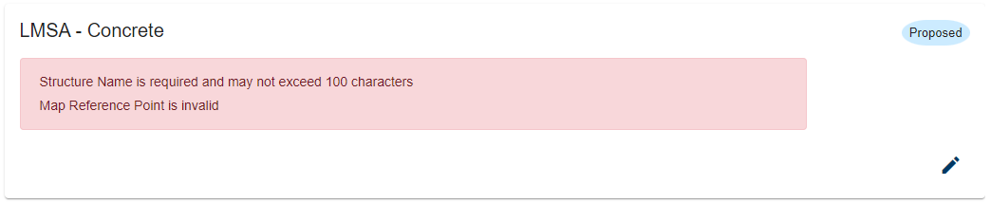
Manure storage
Sites with existing information
Initially, every existing manure storage area will need to be edited
(Unless all manure storage areas are underfloor manure storage)
  Click the edit button
    Add a structure name, structure volume, and update map location
  For manure storage areas with status of “Proposed”,
  edit the status to …
    Active - construction completed
    Under Construction - actively being built or
    still planned but construction not yet started
errors or missing info is identified in the pink box
Notes:
If you are an existing site with pre-populated information, you will need to update some information for every manure storage area. You will need to at least add a structure name and update the map location by clicking the pencil icon to add or edit the data. You will also likely need to enter the volume of the manure storage area.
You should also click the edit button to view and verify that the information pre-populated is correct. If not, you will need to update the information.
If your previous permit authorized construction of a new manure storage area, it will have a status of “proposed”. You will need to change that status of any proposed structure no matter if it has been built, is currently being built, or has not yet been built.
If the construction of the proposed structure has been completed you need to edit the status of that manure storage area to “active” to indicate that construction has been completed. If construction has not yet started, or is in process, use the status of “under construction”.

Slide 69
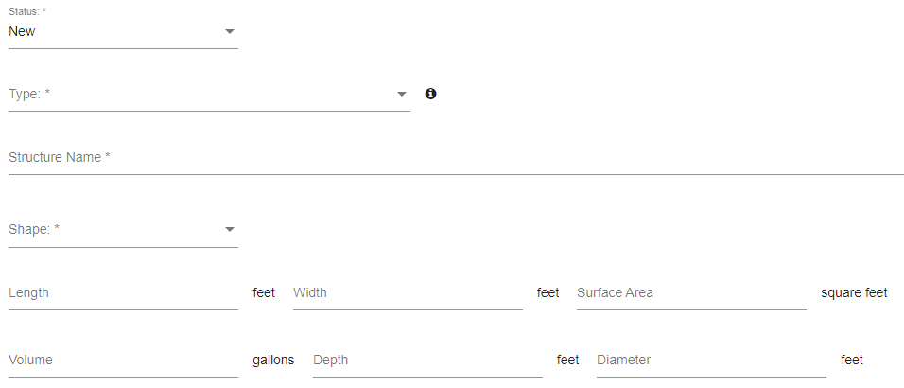
Manure storage
Physical characteristics of each manure storage area
Interactive
Click any data entry field for answers to frequently asked questions
  Click the data entry field a second time to hide the info
Type
Q: My LMSA has different floor and sidewall liners, what type should I use
A: Classify the LMSA according to the floor liner
Example: Earthen sidewalls and concrete floor - use type: LMSA-Concrete
Q: My LMSA has a dual liner, one on top of the other, what type should I use
A: Classify the LMSA according to the primary liner (liner in contact with manure)
Example: Concrete liner underlain by earthen liner - use type: LMSA-Concrete
Q: What type should I use for a stacking slab
A: If the manure that is stored is a solid – use type: Stockpile-Permanent
    Solid manure is both 15% or more solids AND stackable at a 3:1 ratio
    All other stacking slabs are considered LMSAs and would use the type according to the liner material (likely LMSA-Concrete)
    TIP: If there is any doubt consider it a LMSA
Q: The type of my existing structure is wrong, how do I change it
A: 1) Change the status to: To Be Eliminated
2) Add a different structure of the correct type with the status: Active
Status
Q: I am adding on to a LMSA, how do I enter that into the service
A: If the addition plus existing LMSA will managed as one large LMSA…
    Change the status of the existing LMSA to Proposed and indicate the new overall
    (LMSA + addition) dimensions.
If the addition is managed as a “separate” LMSA …
    List the addition as a New LMSA.
Q: I have a manure storage area that was permitted but I have not yet started construction, what should I select for status
A: List this manure storage area as Under Construction
Q: I have closed a LMSA, what should I select for status
A: List this LMSA as To Be Eliminated (even though it has already been closed)
Structure Name
Enter the common name for the manure storage area
It must be unique from other structures at the facility
Example: Primary basin, Runoff pond, etc.
For existing facilities that recently completed construction, be sure to change the status of the completed structures from Proposed to Active.
Length, Width, & Surface Area
Q: I have an irregular shaped structure how do I enter the information
A: Enter the largest length and width in feet and ….
    The surface area for Stockpiles, Filter Strips, and Infiltration basins
    The volume for LMSAs
Shape
Select the general shape of the manure storage area.
This selection will impact which measurements below are displayed/required.
Questions about LMSAs with 2 liner types,
dual-lined LMSAs, stacking slabs, etc.
Click on the data entry fields for more info
Depth
Q: My manure storage area has multiple depths, what should I do
A: Enter the maximum depth
Volume
Q: What volume should I use
A: Enter the permanent storage volume
    Overall volume minus freeboard
Diameter
Enter the top diameter of the circular LMSA
Notes:
On this interactive slide, click on any data entry field to see answers to frequently asked questions about the data that needs to be entered for each manure storage or treatment area.
The online service also has help text available by hovering over the drop down list choices for status and type.
For liquid storage areas with differing floor and wall liner types, select the type that corresponds to the floor liner material.
For liquid storage areas that are dual-lined, one liner placed on top of the other, select the type that corresponds to primary liner, that is, the one in direct contact with the manure.
The dimensions fields will be customized based on the shape you select for your manure storage area. You will not see the diameter field for a rectangular storage area.
Finally if you are going to be adding onto an existing manure storage area – use the interactive slide and click on the status data field for more information on how to enter that addition into the online service.

Slide 70
Mapping the manure storage area
Use the Map to identify the location of each manure storage area
  (Except those associated with a total confinement with underfloor storage animal holding area)
  Zoom in or out and drag across the map to locate the manure storage area.
  Click a point in the center of the manure storage area.
  When a dot appears, click on the save icon below the map.
You do not need to do anything with the coordinates box
Notes:
You will need to map the location of each manure storage or treatment area, except those manure storage areas that are associated with the animal holding area type of “total confinement with underfloor liquid storage”.
Even existing feedlots will need to update the mapped location of their manure storage areas the first time you apply for a permit via the online service.
Using the map tool, zoom and drag the map until you see your facility on the screen. Then simply click a point in the center of the manure storage area. For new manure storage areas indicate the approximate location on the map. Click the save icon below the map to save the updated point on the map.
You can ignore the feedlot coordinates data displayed, it is automatically updated when you click save to update the dot on the map.

Slide 71
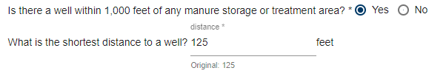
Well proximity
After entering all manure storage area info
  Scroll to the very bottom of the screen
  Answer the well proximity question
    If a well is within 1,000 feet of any storage area
      Enter the shortest distance to the well from the storage area
Notes:
At the very bottom of the manure storage screen you will need to answer questions about well proximity. If a well is within 1,000 ft of any manure storage or treatment area indicate the shortest distance from any manure storage or treatment area to that well.

Slide 72

Attaching construction plans
Upload plans for all new manure storage or treatment areas
  Include all components (Soils investigation, karst surveys, etc.)
  Only PDF files are accepted
Click Upload File to attach the plans
  Select the document in in the popup window to start the upload process
  Enter a document date (approximate date the document was prepared)
This will appear after you begin the upload process
Tip
You can also upload the plans later via the attachments tab
Notes:
Every new manure storage or treatment area, regardless of the type, requires the submittal of design plans.
Design plans are completed outside of the service and the uploaded to the service for MPCA review and approval. To upload a document simply click Upload file and select the file from your computer that you would like to attach to your application. Please note that only PDF files are accepted.
As part of the document upload process you will need to input a document date. This should be the date that the plans were finalized not the date you uploaded them to the service. For plans developed by an engineer use the date the engineer signed the document.

Slide 73
Feed storage
Answer the Feed storage question at the top of the screen
  Existing sites with feed storage areas will not see a question
  Not all feed storage areas need to be permitted
    Only those that are outdoor (even if covered with plastic)
      Includes silage, haylage, earlage, high moisture corn,
      shelled corn, bagged feedstocks, etc.
      Does not include commodity sheds, grain bins, vertical silos, etc.
Enter each Feed storage area separately
Click the button to add more structures
Notes:
Unless your are an existing site with an outdoor feed storage area, you will need to indicate if your feedlot will have an outdoor feed storage area.
Not all types of feed storage areas should be included. It is not necessary to indicate commodity sheds, vertical silos, or grain bins.
Outdoor feed storage areas include those that are covered by plastic or bagged.
You will need to enter information about your feed storage areas one at a time. You can add as many feed storage areas as you need by using the add button.

Slide 74

Feed storage
Sites with existing information
Initially, every existing feed storage area will need to be edited
  Click the edit button
    Add a structure name and update map location
  For feed storage areas with status of “Proposed”,
  edit the status to …
    Active - construction completed
    Under Construction - actively being built or
    still planned but construction not yet started
errors or missing info is identified in the pink box
Notes:
If you are an existing site with pre-populated information, you will need to update some information for every feed storage area. You will need to at least add a structure name and update the map location by clicking the pencil icon to add or edit the data.
You should also click the edit button to view and verify that the information pre-populated is correct. If not, you will need to update the information.
If your previous permit authorized construction of a new feed storage area, it will have a status of “proposed”. You will need to change that status of any proposed structure no matter if it has been built, is currently being built, or has not yet been built.
If the construction of the proposed structure has been completed you need to edit the status of that feed storage area to “active” to indicate that construction has been completed. If construction has not yet started, or is in process, use the status of “under construction”.

Slide 75

Feed storage
Physical characteristics of each feed storage area
Interactive
Click any data entry field for answers to frequently asked questions
  Click the data entry field a second time to hide the info
Status
Q: I am adding on to a feed storage area, how do I enter that
A: If the addition plus existing will managed as one large area…
    Change the status of the existing feed storage area to Proposed and indicate the new overall (existing + addition) dimensions.
If the addition is managed as a “separate” area …
    List the addition as a New feed storage area.
Q: I have a feed storage area that was permitted but I have not yet started construction, what should I select for status
A: List this feed storage area as Under Construction
Q: I have closed a feed storage area, what should I select for status
A: Use status of To Be Eliminated (even though it has already been closed)
Length, Width, & Surface Area
Q: I have an irregular shaped structure how do I enter the information
A: Enter the largest length and width in feet AND the surface area in square feet
Structure Name
Enter the common name for the feed storage area
It must be unique from other structures at the facility
Example: Silage pile, Earlage, etc.
For existing facilities that recently completed construction, be sure to change the status of the completed structures from Proposed to Active.
Shape
Select the general shape of the feed storage area.
Notes:
On this interactive slide, click on any data entry field to see answers to frequently asked questions about the data that needs to be entered for each feed storage area.
The online service also has help text available by hovering over the drop down list choices for status.
Finally if you are going to be adding onto an existing feed storage area – use the interactive slide and click on the status data field for more information on how to enter that addition into the online service.

Slide 76
Mapping the feed storage area
Use the Map to identify the location of each feed storage area
  Zoom in or out and drag across the map to locate the feed storage area.
  Click a point in the center of the feed storage area.
  When a dot appears, click on the save icon below the map.
You do not need to do anything with the coordinates box
Notes:
You will need to map the location of each feed storage area. Even existing feedlots will need to update the mapped location of their feed storage areas the first time you apply for a permit via the online service.
Using the map tool, zoom and drag the map until you see your facility on the screen. Then simply click a point in the center of the feed storage area. For new feed storage areas indicate the approximate location on the map. Click the save icon below the map to save the updated point on the map.
You can ignore the feedlot coordinates data displayed, it is automatically updated when you click save to update the dot on the map.

Slide 77
Mortality management
Answer the mortality question at the top of the screen
  Not all mortality areas need to be permitted
    Only compost areas that use manure or litter
    as the compost material
      Does not include dead boxes, burial sites, incinerators, etc.
      Does not include mortality compost that use wood shavings for the compost material
Enter each mortality compost area separately
Click the button to add more structures
Notes:
All sites, even those that already have a mortality management area, will initially need to indicate if the feedlot will have an animal mortality compost area that uses manure or litter as part of the compost material.
It is not necessary to indicate dead boxes, burial areas, incinerators, or other mortality management areas.
You will need to enter information about your mortality compost areas one at a time. You can add as many mortality compost areas as you need by using the add button.

Slide 78

Mortality compost areas
Sites with existing information
Click the edit button to edit existing structure info
  For mortality compost areas with status of “Proposed”,
  edit the status to …
    Active - construction completed
    Under Construction - actively being built or
    still planned but construction not yet started
Notes:
If you are an existing site with pre-populated information, you can click the pencil icon to view and add or edit the data for the mortality compost area.
You should also click the edit button to view and verify that the information pre-populated is correct. If not, you will need to update the information.
if your previous permit authorized construction of a new mortality compost area, it will have a status of “proposed”. You will need to change that status of any proposed structure no matter if it has been built, is currently being built, or has not yet been built.
If the construction of the proposed structure has been completed you need to edit the status of that mortality compost area to “active” to indicate that construction has been completed. If construction has not yet started, or is in process, use the status of “under construction”.

Slide 79

Mortality management
Physical characteristics of each mortality compost area
Interactive
Click any data entry field for answers to frequently asked questions
  Click the data entry field a second time to hide the info
Status
Q: I am adding on to a mortality area, how do I enter that
A: If the addition plus existing will managed as one large area…
    Change the status of the existing mortality storage area to Proposed and indicate the new overall (existing + addition) dimensions.
If the addition is managed as a “separate” area …
    List the addition as a New mortality area.
Q: I have a mortality management area that was permitted but I have not yet started construction, what should I select for status
A: List this mortality area as Under Construction
Q: I have closed a mortality compost area, what should I select for status
A: Use status of To Be Eliminated (even though it has already been closed)
For existing facilities that recently completed construction, be sure to change the status of the completed structures from Proposed to Active.
Structure Name
Enter the common name for the mortality area
It must be unique from other structures at the facility
Length, Width, & Surface Area
Q: I have an irregular shaped structure how do I enter the information
A: Enter the largest length and width in feet AND the surface area in square feet
Notes:
On this interactive slide, click on any data entry field to see answers to frequently asked questions about the data that needs to be entered for each mortality compost area.
The online service also has help text available by hovering over the drop down list choices for status.
Finally if you are going to be adding onto an existing mortality area – use the interactive slide and click on the status data field for more information on how to enter that addition into the online service.

Slide 80
Mapping the mortality area
Use the Map to identify the location of each mortality compost area
  Zoom in or out and drag across the map to locate the mortality compost area.
  Click a point in the center of the mortality compost area.
  When a dot appears, click on the save icon below the map.
You do not need to do anything with the coordinates box
Notes:
You will need to map the location of each mortality compost area. Even existing feedlots will need to update the mapped location of their mortality compost areas the first time you apply for a permit via the online service.
Using the map tool, zoom and drag the map until you see your facility on the screen. Then simply click a point in the center of the mortality compost area. For new mortality compost areas indicate the approximate location on the map. Click the save icon below the map to save the updated point on the map.
You can ignore the feedlot coordinates data displayed, it is automatically updated when you click save to update the dot on the map.

Slide 81
Air emissions plan
Required for every NPDES and SDS permit application
  Read the information on the screen
    Minimum requirements of an approvable air emissions plan
    Can “add more” to the plan via an attached document
  Check the box at the top of the screen
Notes:
You must read and agree to follow the air emissions plan displayed in the online service by checking the box at the top of the screen. This represents the minimum content of an adequate air emissions plan. If you want to add more to the plan you can attach additional information via the “supporting Documents” in the attachments tab.

Slide 82
Sensitive areas
Answer the yes/no questions
FAQ - How is “shoreland” determined
  Each county designates the areas that are considered shoreland
    Check with your county
    Generally within 1,000 ft of a lake or
    within 300 ft of a river/stream
Notes:
Answer the yes no questions to complete the section on sensitive areas. Keep in mind that these questions should be answered yes if any part of the facility is within the areas indicated.

Slide 83
Environmental review
Answer the yes/no questions
  More may appear based upon your answers
    You will have to answer all of them before you can advance
If environmental review is required you will need to …
  Upload the environmental assessment worksheet (EAW)
    With supporting materials
  Pay the associated fee
    In addition to the permit fee
  Wait for the completion of the environmental review process before a permit can be issued
    Expect 4-6 months
Notes:
You will need to answer the yes/no questions on this screen to help determine is environmental review is needed before your permit can be issued.
More yes/no questions will appear based upon your initial answers.
You must answer all the questions before you can advance, even those that are not typically applicable to feedlots.
If environmental review is required you will need to upload the documents as part of the permit application.

Slide 84
Mandatory environmental review
Mandatory for any of the following situations
  Brand new site with 1,000 or more AU
  Existing site expands by 1,000 or more AU within a
  3 year period
  Commonly owned sites within the same geographic area expand by a cumulative total of 1,000 or more AU within a 3 year period
        Generally geographic area is less than 6 miles
          Does not mean that all sites within 6 miles are in the same geographic area – case by case determination
  Note: Thresholds drop to 500 AU if in a sensitive area: Shoreland, floodplain,
  <1,000 ft to a karst feature, vulnerable DWSMA’s, or wild/scenic river districts
Notes:
Environmental review is mandatory of you are….
Building a brand new facility with the capacity of 1,000 or more animal units or
Are expanding an existing site by a capacity of 1,000 or more animal units in a 3 year period.
It is also possible that environmental review is required because, the cumulative total of expansion at all sites you own within the same geographic area is 1,000 animal units or more within the past three years. This is referred to as a phased action. The extent of the same geographic area depends on a number of factors and is determined on a case by case basis. Generally, facilities that are at least 6 miles apart are not considered to be in the same geographic area.
One important note is that the threshold for mandatory environmental review drops to 500 or more animal units in sensitive areas.

Slide 85
Facility monitoring
Answer the initial yes/no question
  Answer yes if you are required by the MPCA to perform monitoring of your facility (not very common)
    Typically groundwater or tile line monitoring
    You will need to …
      Upload the facility monitoring plan (on attachments screen)
      Provide information about each monitoring location
Enter each monitoring location separately
Click the button to add more locations
Notes:
You will need to answer the yes/no questions on this screen to indicate if your facility is required by the MPCA to perform monitoring of potential emissions.
Monitoring at feedlots typically consists of groundwater sampling via monitoring wells or tile lines associated with liquid manure storage areas.
If you are one of the limited number of facilities that is required to monitor, you will need to upload a copy of the monitoring plan that you are following and input information about the type and frequency of monitoring you are doing.
You will need to enter information about your facility monitoring locations one at a time. You can add as many facility monitoring locations as you need by using the add button.

Slide 86

Facility monitoring
Characteristics of facility monitoring activities
Interactive
Click any data entry field for answers to frequently asked questions
  Click the data entry field a second time to hide the info
Ananlyte & Frequency
Select the analysis that is done on the sample
(add analytes as needed to identified all tests required)
Select the required frequency of the sampling
Status
Most commonly the status will be active
(ie. monitoring well is installed and required to be sampled)
Type
Most water sampling activities will have the type: Groundwater
This includes all monitoring wells and most perimeter tiles of LMSAs
Use Surface Discharge if a sample is collected from a perimeter tile after it discharges on the surface or other sources that discharge on the landscape
Use Surface Water if you are required to perform sampling of a surface water body (ie. lake, river, stream, wetland)
Description
Enter the common name for the monitoring point
This is typically identified in the monitoring plan
Example: MW-1, Tile line, up-gradient well etc.
Click here for additional lines to provide info about all required analytes for this location
Notes:
On this interactive slide, click on any data entry field to see answers to frequently asked questions about the data that needs to be entered for each facility monitoring point.
The online service also has help text available by hovering over the drop down list choices for status.
You will likely need to click the add button in order to list all the types of tests performed on the sample obtained from this monitoring location.

Slide 87

Mapping the monitoring point
Use the Map to identify the location of each monitoring point
  Zoom in or out and drag across the map to locate the general monitoring area.
  Click the actual location where the monitoring point is located.
  When a dot appears, click on the save icon below the map.
Alternatively if you know the exact coordinates of the monitoring point you can input them into the coordinates box
Notes:
You will need to map the location of each facility monitoring point. You can either use the map or enter the precise longitude and latitude.
To use the map tool, zoom and drag the map until you see your facility on the screen. Then simply click the point where the sample is taken. Click the save icon below the map to save the updated point on the map. This will automatically update the monitoring coordinates data to the left of the map.
If you have the precise longitude and latitude of the facility monitoring point you can enter it into the monitoring coordinates box to update the dot on the map.

Slide 88
Manure management plan (MMP)
Answer the initial question about manure transfer
  Manure is considered transferred when ….
    Manure is applied to land NOT owned, leased, rented, or otherwise operated by the feedlot ownership entity
    AND
    No member of the feedlot ownership entity controls nutrient application decision for the crops/field
  Example: Manure ownership is NOT transferred when manure is applied to land operated by a partner of the LLP that owns the feedlot
Notes:
You will need to answer the question about how much manure you transfer.
Manure ownership is considered transferred if… manure is applied to land that is NOT owned, leased, rented, or otherwise operated by the feedlot ownership entity… AND… no member of the ownership entity controls the nutrient application decisions for that field.
As an example, manure ownership is NOT transferred when manure is applied to land operated by a partner of the LLP that owns the feedlot.

Slide 89
Manure management plan (MMP)
If ALL manure is transferred
  Upload the Manure Transfer Plan using the MPCA form
If NO manure is transferred
  Upload the data file from the MPCA MMP spreadsheet
If SOME manure is transferred
  Upload the Manure Transfer Plan using the MPCA form
  AND
  Upload the data file from the MPCA MMP spreadsheet
Notes:
If ALL manure is transferred you will need to upload the completed Manure transfer plan. You must use the MPCA standardized form. A link to the form is provided in the online service.
If NO manure is transferred you will need to upload the data file from the MPCA MMP spreadsheet. The next slide will have more information about the MPCA MMP Spreadsheet and the associated data file. A link to the spreadsheet is provided in the online service.
If some manure is transferred you will need to upload both the Manure Transfer Plan and the data file from the MMP Spreadsheet.

Slide 90

Manure management plan (MMP)
What is the MPCA MMP Spreadsheet data file
The MPCA MMP spreadsheet is designed to save only the data that is entered into the program
  This is called the data file
Only the data file can be uploaded to your application
  To produce the data file follow these steps
    Complete a MMP using the MPCA MMP spreadsheet
    From the Add-Ins menu in the program select Save Farm Data
    A
    The data file will now be saved to the location you specified
      More guidance on the MPCA MMP spreadsheet can be found here: https://www.pca.state.mn.us/sites/default/files/wq-f6-12b.pdf
Notes:
The MPCA MMP spreadsheet is a Microsoft excel based program that is used to develop a MMP that complies will all requirements of the state feedlot rules and applicable permit requirements. You can download a copy of the program from MPCA website.
Once you have created a MMP with the program you will need to save the data for your farm. This is accomplished by navigating to the add-ins menu within the MMP spreadsheet program and clicking “Save Farm Data”. This will produce a second excel file that just contains the data you entered into the MMP spreadsheet. It is this file that will need to be uploaded to the online permit application service. No other file types will be accepted. You cannot simply upload a PDF of the completed MMP spreadsheet, only the data file will be allowed to be uploaded to the service.
If you need help developing a MMP with this spreadsheet please refer to the guidance document link provided in this tutorial.

Slide 91

Attaching a MMP
Transfer plan or MMP spreadsheet data file
Click Upload File to attach the required document(s)
  Select the document in in the popup window to start the upload process
  Enter a document date (approximate date the document was prepared)
Note: Field maps are required for any fields listed in the MMP data file (ie. non-transferred manure). They are uploaded via the attachments screen along with any other MMP supporting documents.
This will appear after you begin the upload process
Tip
You can also upload the plans later via the attachments tab
Notes:
As the MMP documents are completed outside of the service, you will need to upload them to the service for MPCA review and approval. To upload a document simply click Upload file and select the file from your computer that you would like to attach to your application.
As part of the document upload process you will need to input a document date. This should be the date that the plans were finalized not the date you uploaded them to the service.
Field maps are required to accompany the MMP spreadsheet data file. These are uploaded to the service via the attachments tab.

Slide 92
Attachments
An application cannot be submitted without all required attachments
  Any documents uploaded during a previous step are shown
Click Upload File to attach a document
  Select the document in in the popup window to start the upload process
  Enter a document date (approximate date the document was prepared)
  Repeat the upload process for multiple files of the same type (ie. field maps)
Click here for a description of possible attachments
Click here to view the document you uploaded to verify it is correct
Click here to delete the document you uploaded
This will appear after you begin the upload process
Tip
Scroll all the way to the bottom to see all required attachments
Notes:
Before an application can be formally submitted ALL required attachments must be uploaded to the online service.
The attachments screen provides a list of all required and optional attachments. To upload a document simply click Upload file and select the file from your computer that you would like to attach to your application.
As part of the document upload process you will need to input a document date. This should be the date that the plans were finalized not the date you uploaded them to the service.
Some types of attachments are limited to one uploaded document, others allow multiple document uploads.
If you uploaded a document earlier in the service it will appear in the list on the attachments screen.
For documents that do not fit into one of the provided document types, upload it to the “supporting application documents” section of the attachments screen.
Be sure to scroll all the way to the bottom to verify all required attachments have been uploaded to the service.

Slide 93
Attachments (most common) links provided for forms/more info
Construction plans and specifications
  Plans for any new manure storage or treatment area
    Plans for LMSAs require professional engineer
Manure transfer plan
  How manure that is sold or given away is managed
    Must use the MPCA standardized form
MMP data file
  The manure management plan for non-transferred manure
    Must us the MMP spreadsheet and attach the data file from the program
Field maps
  Maps of all fields in the MMP (non-transferred manure) – most commonly aerial photos
    Include identification of sensitive features and setbacks
Verification of good neighbor notice
  Evidence that the notice was completed – typically a newspaper affidavit of publication
Emergency response plan
  Plan (with contacts) to respond to emergencies at the facility (spills, fire, etc.)
Notes:
Construction plans and specifications are required for all new manure storage or treatment areas. It is not required to upload plans for existing structures.
A manure transfer plan is required if any amount of manure is transferred. It must be completed on the MPCA standardized form.
Use of the MPCA MMP spreadsheet is required when not all manure is transferred. You must upload the MMP data file from this spreadsheet.
Fields maps, which are most commonly aerial photos, are required for any field listed in the MPCA MMP spreadsheet data file, even if it is not used for land application in the current planning year. The maps need to identify all sensitive features and setbacks that will be observed near these features.
When a facility of 500 or more animal units and is constructing or expanding, the feedlot owner is required to provide notice of the planned construction or expansion to residents and land owners within 5,000 ft of the facility. This is referred to as the good neighbor notice. You will need to provide evidence that this notice was completed. For more information about this notice click on the orange hyperlink text.
An emergency response plan that outlines the facilities plan to respond to spills, fires, or other emergencies will be also need to be uploaded to the service for NPDES and SDS permit applications. The recommended form for this plan can be obtained by clicking on the orange hyperlink text.

Slide 94
Attachments (less common) links provided for forms/more info
Non-delegated county public meeting minutes
  Official minutes from the Non-delegated county meeting about the project
Environmental review document
  Environmental assessment worksheet (EAW) form
    Including any associated documents (ie. air modeling results)
Stormwater pollution prevention plan (SWPPP)
  How stormwater will be managed during and after construction – use MPCA form
    General site runoff – not manure contaminated runoff
MN agricultural water quality certificate
  Evidence of completion of the MN ag water quality certification process
Monitoring plan
  Plan to perform agency required monitoring
    Only water monitoring at this time
Supporting application documents
  Any other documents that you would like to provide as part of your application
    Soil test results, manure test results, additional air emissions practices, etc.
Notes:
When a facility of 300 or more animal units is constructed or expanded in a non-delegated county, the county is required to hold a public meeting about the proposal. You will need to provide the official minutes from this meeting.
When environmental review is required, you will need to upload the EAW form, air modeling results, and other documents associated with the environmental review process. More information about the required documents can be obtained via the orange hyperlinks provided.
When construction activities at a feedlot disturb one or more acres, a stormwater pollution prevention plan, or SWPPP, is required. Use of the MPCA form is recommended. The document is only required to be uploaded to the online service when 50 or more acres of land are disturbed.
If the facility is a MN agricultural water quality certified farm, please attach evidence of completion of that certification process.
The monitoring plan outlines the location, type, and frequency of MPCA required facility monitoring. Upload the MPCA approved monitoring plan.
The “supporting application documents” section of the attachments screen is used to upload documents that do not fit into the other categories. Some common examples include soil or manure test results or MN phosphorus index results.

Slide 95
Summary screen
All the information gathered throughout the service
  Also emailed after submittal (copy of record)
Review the information to check for errors before advancing
  Fix errors by navigating back to applicable section via the tabs at the top of the screen
    No way for you to go back and change something after it is submitted
    Be sure to use the save button at the bottom of the tab where changes were made
Must scroll all the way to the bottom and click Next to advance
Notes:
The summary screen is a list of all information gathered throughout the completion of your application via the online service, which is known as the copy of record. You will also receive this via email.
Review this information and verify that it is accurate and correct. If not, use the tabs at the top of the screen to navigate back to a section to correct issues.
You must scroll all the way to the bottom of the page to click the next button to proceed.

Slide 96

Certification
Feedlot Preparer
  Only sees Notify Signatory button
    Click this button to alert feedlot signatory that
    the application is ready to sign
Feedlot Signatory
  Only sees Sign Electronically button
    Click this button to sign the application
Notify Signatory
Notes:
The certification process is where you will actually sign and formally submit the application.
Based on your level of facility access you will only see one of the two buttons shown.
Click on the button available to you to proceed with signing the application.

Slide 97

Certification
Notify Signatory
Only feedlot preparer (ie. consultant) will see this screen
  Select the signatory you want to notify (if more than 1)
  Click Notify to alert the signatory that the application is ready to sign
    Service sends an email with instructions
Example
Example
Feedlot DEMO
Click here for a description of what the owner will see/do once notified
Notes:
If you only have feedlot preparer access you will need to select a feedlot signatory and then click the notify button. This alerts them that you have completed your work and the application is ready for them to sign. The service will automatically send them an email with instructions on how to sign the application.
After the application is signed, either you, or the owner, can pay the applicable permit application fee and formally submit the application to the MPCA.
If you would like to see the screens that the owner will need to complete click the cloud icon.

Slide 98

Certification
Feedlot signatory (owner) signs electronically
Read the certification statement
  Answer the challenge question and click Certify
Feedlot DEMO
Example
Notes:
As the feedlot signatory you will need to read the certification statement and then sign the application by first answering the challenge question correctly and then clicking the certify button.

Slide 99

Certification
Application signed
Once the application is signed click Submit
Feedlot DEMO
Notes:
Once the application has been signed click the Submit button to formally send your application to the MPCA for review.
After you click submit you will no longer be able to edit information within the application via the online service.

Slide 100

Success - Submittal
Successful application submittal
  Email confirmation of successful submittal
Notes:
If submittal was successful you will see a green bar at the top of the screen alerting you to the success. You will also receive email confirmation that the information was successfully submitted to the MPCA.

Slide 101
Application processing
MPCA staff review the information electronically submitted
  If clarification/correction is required you will be contacted via email
  After completion of submittal review …
    Permit is issued – copy sent via email
      From receipt date to issuance is typically 30 - 45 days
        Except for applications that need environmental review or have significant public interest
Notes:
Once the application is received by the MPCA, staff will begin review of the information you submitted. Up until submittal the MPCA does not have access to any information within your in-progress application. If the review indicates more information is required, you will be contacted via email from the MPCA.
After the review process is completed the MPCA will provide your permit to you via email. The entire review process typically takes 30 – 45 days from the submittal date but this can take longer when environmental review is required, there is significant public interest in the proposal, or you or your consultant fail to respond to the MPCA in a timely manner with any requested information.

Slide 102

Certification
Application signed
Once the application is signed click Next
  Application is not yet submitted
Feedlot DEMO
Notes:
Once the application has been signed click the Next button.

Slide 103


Payment
Click Make Payment to pay fees
  Complete the necessary bank/card info (not shown)
Notes:
You will now need to pay the applicable permit application fee. You can pay via e-check, debit card, or credit card. The processing fee for each payment type is listed.
Click on Make Payment and complete the required information to properly pay the applicable fee.

Slide 104

Success - Submittal
Successful application submittal
  After payment clears submittal review starts
    Email confirmation of successful submittal and payment
Notes:
If submittal was successful you will see a green bar at the top of the screen alerting you to the success.
Once your payment clears the bank, you will receive email confirmation that the information was successfully submitted to the MPCA.

Slide 105
Application processing
MPCA staff review the information electronically submitted
  If clarification/correction is required you will be contacted via email
  After completion of submittal review …
    Public notice (if required) takes place
      30 days for public comment
        MPCA must respond to comments received
    Permit is issued – copy sent via email
      From receipt date to issuance is typically 60 - 90 days
        Except for applications that need environmental review or have significant public interest/comments
Notes:
Once the application is received by the MPCA, staff will begin review of the information you submitted. Up until submittal the MPCA does not have access to any information within your in-progress application. If the review indicates more information is required, you will be contacted via email from the MPCA.
After the review process is complete the MPCA will place your permit on public notice for 30 days for public comment. The MPCA must respond to the public comments received.
After the public notice process is completed the MPCA will provide your permit to you via email. The entire review process typically takes 60 – 90 days from the submittal date but this can take longer when environmental review is required, there is significant public interest in the proposal, or you or your consultant fail to respond to the MPCA in a timely manner with any requested information.

Slide 106
The End
For more assistance:
Feedlot Staff Contact Info
https://www.pca.state.mn.us/water/mpca-feedlot-staff-contacts
Feedlot homepage: www.pca.state.mn.us/feedlots
Notes:
This concludes the MPCA online permit service tutorial. If you need more assistance please contact your regional MPCA feedlot staff person. Contact info can be found via the orange hyperlink text.
For more information on the MPCA feedlot program, including additional information about the permitting program, please visit the MPCA feedlot program homepage.

Slide 107
The End
For more assistance:
Feedlot Staff Contact Info
https://www.pca.state.mn.us/water/mpca-feedlot-staff-contacts
Feedlot homepage: www.pca.state.mn.us/feedlots
Notes:
This concludes the MPCA online permit service tutorial. If you need more assistance please contact your regional MPCA feedlot staff person. Contact info can be found via the orange hyperlink text.
For more information on the MPCA feedlot program, including additional information about the permitting program, please visit the MPCA feedlot program homepage.

