Slide 1

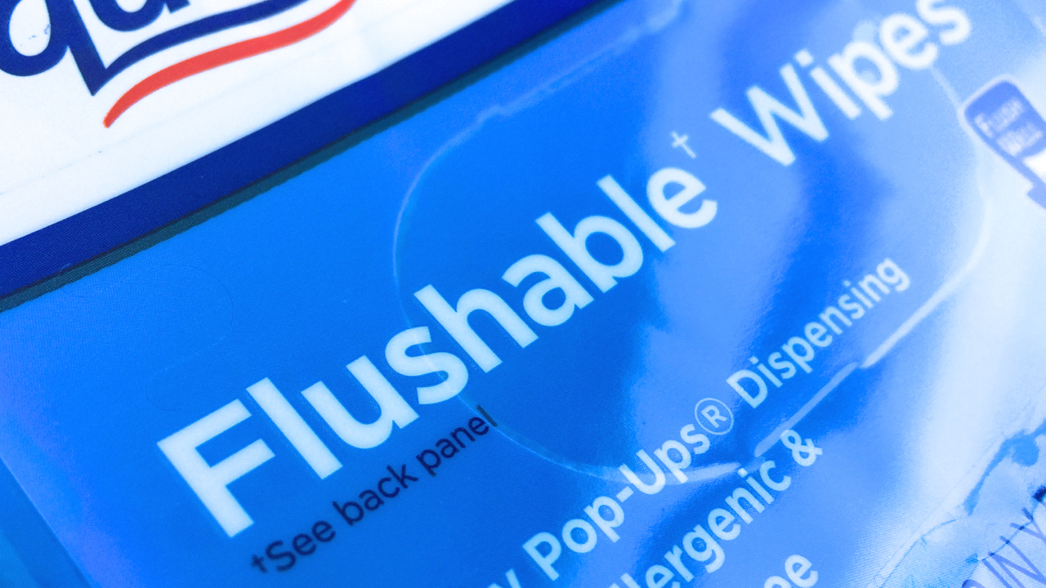
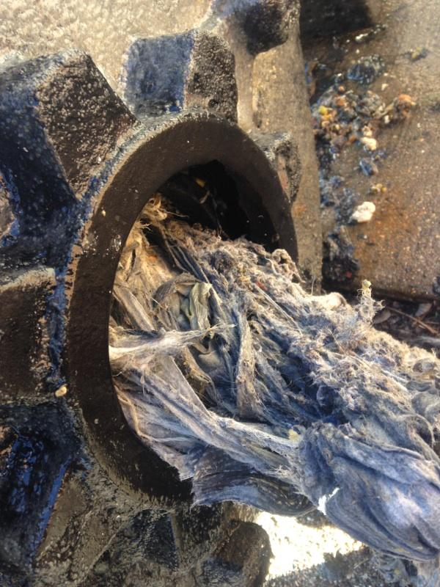

“Flushable.” Really?
INSERT CITY LOGO AND WEBSITE ADDRESS

