Slide 1
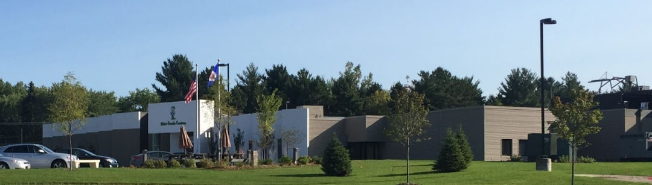

Water Gremlin air emissions: TCE
February 21, 2019

Slide 2

Presentation overview
  Welcome
  Overview of Water Gremlin facility
  Timeline of recent investigations
  Trichloroethylene (TCE) and health
  Q & A
Notes:
Welcome to all;
We will have more time after the presentation to address individual questions you may have after the meeting.

Slide 3
Agency roles
Minnesota Pollution Control Agency (MPCA)
Mission: To protect and improve the environment and human health.
Minnesota’s environmental protection agency
Regulate facilities to protect the environment and community health
Minnesota Department of Health (MDH)
Mission: To protect, maintain and improve the health of all Minnesotans.
Minnesota’s primary public health agency
Set exposure guidelines to protect community health
Educate the public about chemicals in the environment

Slide 4
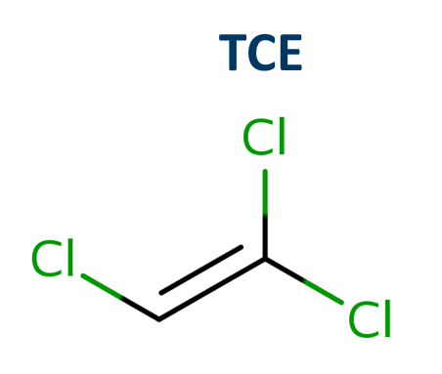
Trichloroethylene (TCE)
Colorless liquid, nonflammable, sweet odor
Volatile organic compound (VOC) – easily moves into the air and disperses
Used to degrease metal parts; also in some household products
Broken down by sunlight, natural processes
Notes:
TCE is a colorless liquid or gas primarily used to degrease metal parts but it is also in many household products such as wood finishes, adhesives, paint removers, lubricants, and cleaners
TCE is in a class of chemicals known as volatile organic compounds or VOCs, meaning these types of chemicals easily move from water into air

Slide 5
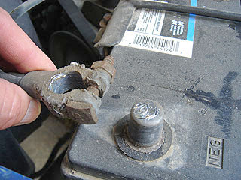
What happened?
Water Gremlin uses TCE in their battery post terminal process
The facility’s control equipment was supposed to remove TCE from the gas stream prior to exiting the building
July 2018 audit identified control equipment issues
Battery posts are the small metal pieces found on top of your vehicle’s battery.

Slide 6
Water Gremlin timeline of events
May-July 2002
Control equipt break-
downs
Aug. 2002
Feb. 2003
MPCA notified equipt rebuilt
MPCA reissues air permit requiring at least 95% CE efficiency
2010-2018
Extensive repairs
Periodic shutdown/ break-downs
July 2018
Audit Report shows permit viola-tions
Oct. 2018
MPCA receives major air permit amend-ment
Dec. 2018
MPCA learns CE has not achieved 95% control since at least 2009. CE running with unknown efficiency
MPCA exchanges emissions info with WG
Jan. 14, 2019
MPCA requests WG shut down TCE coating process
Dec – Jan 2019
Sept. 2006
2000
WG first installs control equipt
Notes:
Over the years the facility has reported shutdowns and breakdowns of the control equipment- this is not unusual with any facility- equipment requires maintenance. shutdowns and breakdowns are not uncommon with any facility
Between July and December the MPCA requested and continued to request information. With each request we became more concerned and had to request further information. Investigations are often like that, where you turn over one rock and find more underneath until you gain an understanding of the full picture
Then, late in the afternoon on January 11th we received the last piece of information that fully demonstrated the magnitude and history of the emissions. At that point we immediately requested the facility shutdown the TCE process which they did. If they hadn’t have shutdown we would have obtained a court order for shutdown

Slide 7
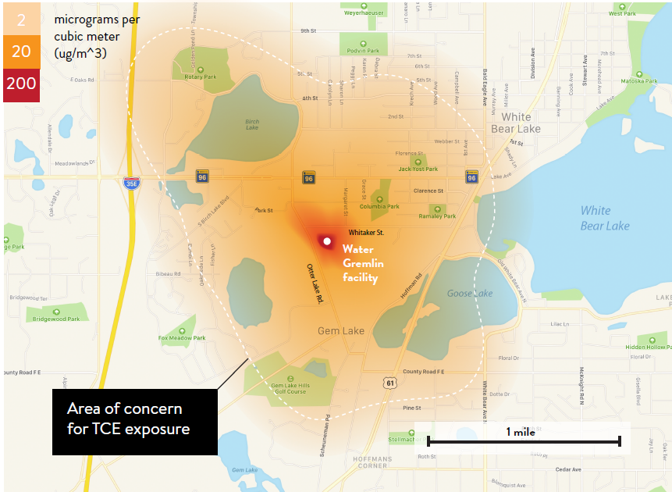
Investigation and next steps
Water Gremlin has been exceeding the chronic health benchmark for TCE inhalation exposure since at least 2009
  MPCA is continuing to investigate
  Water Gremlin has committed to switching to a different solvent and installing new control equipment
  MPCA will not allow any process to re-start unless we are certain there won’t be human health impacts

Slide 8
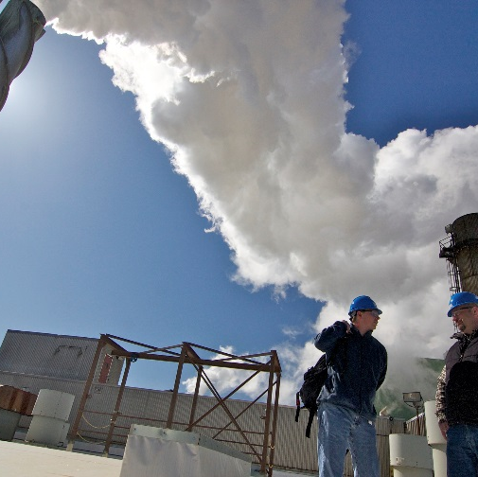
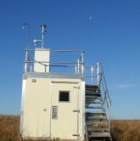

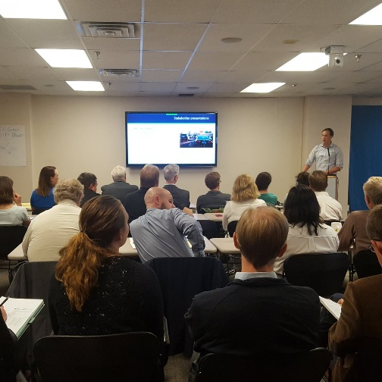
How will MPCA and MDH address the situation?
Permitting
Air monitoring/
air modeling staff
Regulatory
Public information

Slide 9
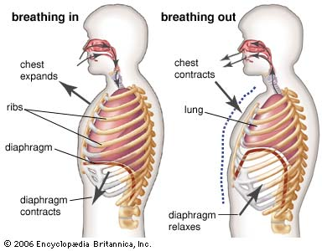
TCE exposure in ambient air
Wind, temperature, location, time are important
Differences between individuals in how they take in and eliminate TCE
Difficult to estimate how much is absorbed
Actual internal exposures can vary greatly between people
TCE is hard to test for, and would only reflect very recent exposure
Notes:
TCE test would only reflect days old exposure and the company has not been using TCE for the last several weeks.
Cite for Media Type - Image
Website Name - Encyclopædia Britannica
Publisher - Encyclopædia Britannica
Url - https://www.britannica.com/science/human-respiratory-system/The-mechanics-of-breathing/media/499530/99770
Access Date - February 5, 2019

Slide 10
MDH Guidance Values for TCE
MDH develops and uses health guidance values to protect people’s health from contaminants in air and water
  Health guidance value: a concentration of a chemical that is likely to pose little or no risk to human health; based solely on health effects information
Designed to be very protective
  Incorporate uncertainty factors during our review of scientific data
  Protective for ALL people, including the most sensitive individuals
  Protective for all time periods
Health guidance values are NOT bright line values
Notes:
MDH develops and uses health guidance values to protect people’s health from contaminants in drinking water
By definition a health guidance value is a concentration of a chemical that poses little or no risk to human health and it is based solely on health effects information
The values are designed to be VERY protective, and I’ll give you some examples of what I mean by that
When our toxicologists develop the values, they incorporate uncertainty factors (added layers of protection) to account for the assumptions that have to be made when reviewing the scientific data
The values ensure protection for the most highly exposed or sensitive individuals and are therefore likely over-protective for everyone else
The values are protective for all household uses of tap water, not just drinking water ingestion – accounts for exposures while cooking, bathing, etc.
The most important point to make is that health guidance values are NOT bright line values from a health standpoint, meaning we do not expect to see health effects if you drink water slightly over our values
They are used to provide health information, to assess potential risks at contaminated sites and are often used by agencies like MPCA to protect groundwater in Minnesota.

Slide 11
TCE Health Guidance Values
MDH Guidance for TCE in air (micrograms per cubic meter) | Who does it protect? | What is it based on?
2 ug/m³ | Protects all people exposed at any time during their life from non-cancer effects | Developmental and immune system effects
2 ug/m³ | Protects all people exposed for a lifetime from cancer | Kidney cancer, non-Hodgkin’s Lymphoma, liver cancer
Notes:
You can see here that MDH has developed a two-tiered guidance for TCE and I’d like you to focus on the green line
We consider a TCE drinking water concentration of 0.4 parts per billion, or less, safe to consume over an entire lifetime
This value is based on protecting children and bottle-fed infants (who drink a lot more water per body weight than adults) and is therefore the number that drives the actions taken by fellow agencies
0.4 ppb is also protective of pregnant women and other sensitive people, such as those with compromised immune systems.
The second line in gray is our cancer value, which MDH develops if the scientific literature indicates a cancer risk. So at 2 ppb of TCE in drinking water, all people who are exposed for a lifetime are protected from cancer. Often, cancer is the most sensitive health effect but in the case of TCE, we’ve determined the developmental and immune system effects to be the reason to take action at the 0.4 ppb level.
And to wrap up my piece, I do want to point out that at the levels of TCE we are currently seeing in this area, we do not expect to see any of the health effects listed here. And with that I’ll let the folks from the Minnesota Pollution Control Agency say more on the TCE groundwater investigation.

Slide 12
Theoretical cancer risks
Increased kidney cancers in workers breathing very high concentrations
Some evidence for TCE-induced liver cancer and lymphoma
2 µg/m³ = considered a negligible risk - 1 extra cancer diagnosis in 100,000 people exposed for a lifetime
20 µg/m³ = 1 in 10,000 additional cancer risk
200 µg/m³ = 1 in 1,000 additional cancer risk
Notes:
Background lifetime cancer risk in MN: ~45,000 in 100,000

Slide 13

Immune system
Rodent studies indicate TCE may cause immune system effects
2 µg/m³ = safe concentration to breathe for a lifetime
~200 µg/m³ – human equivalent concentration – a subtle effect level (decreased thymus weight) in a mouse study

Slide 14

Fetal heart defects
Using the best information available (i.e., studies of rodents exposed to TCE) to estimate the risk from continuous exposure to TCE at ~20 µg/m3 in air, we believe very few women (no more than 1 in 100) would have an amount of TCE in their body that might cause a fetal heart defect more than 1% of the time.
2 µg/m³ = safe concentration

Slide 15


Occupational standards: 8-hour exposures
Workplace TCE standards are much higher than MDH health-based values:
MN OSHA 270,000 µg/m³
ACGIH 55,000 µg/m³

Slide 16
TCE in the air near Water Gremlin

Slide 17
Conclusions
While health risks are low, the community needed to know about possible exposure to TCE
Breathing an amount of TCE that exceeds an HBV does not mean health effects will occur
Exposures varied greatly; some exceeded MDH guidance values – perhaps over several years
There is no simple medical test for TCE exposure, especially past exposures
Work with your care provider to determine what is best for your individual health

Slide 18
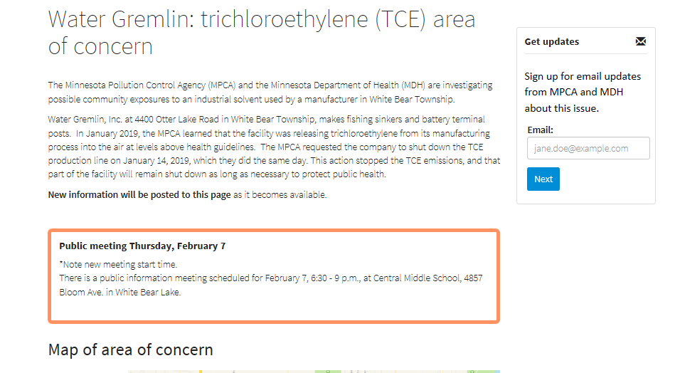
Stay informed
TCE area of concern webpage
Join our e-mail list for updates
www.health.state.mn.us

Slide 19
Thank you!
Sarah Kilgriff
Manager
Land and Air Compliance Industrial Division
James Kelly, M.S.
Manager
Environmental Surveillance
and Assessment
Notes:
We will stay as long as we need to answer questions after this presentation – point out staff.
Thanks for your attention.

