Slide 1

Welcome to the training!
We will begin shortly.
You are muted. During the presentation, please leave your video off.
This presentation will be recorded. The recording and the slides will soon be available on our website.
To ask a question today:
Type in the chat box, or
Use the “Raise your hand” function and we will unmute you:
Click the participants list
Click the hand next to your name
Notes:
We’ve muted everyone on entry and we ask that you please keep you video and sound off during the presentation. We are recording this presentation and will have it available on our website for viewing after today’s session.

Slide 2
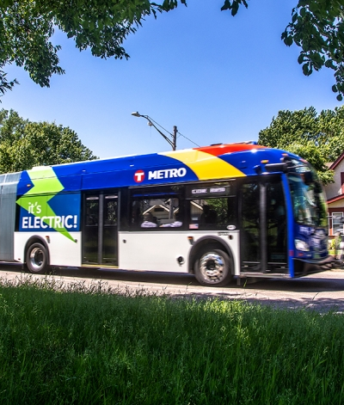
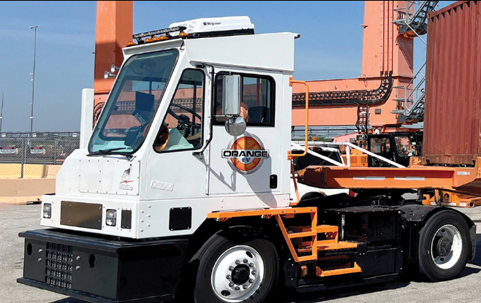
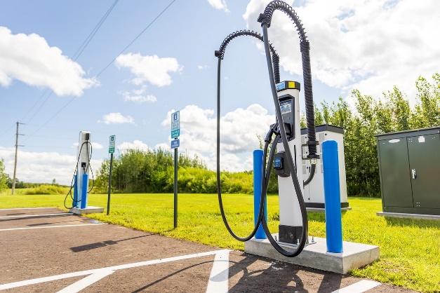
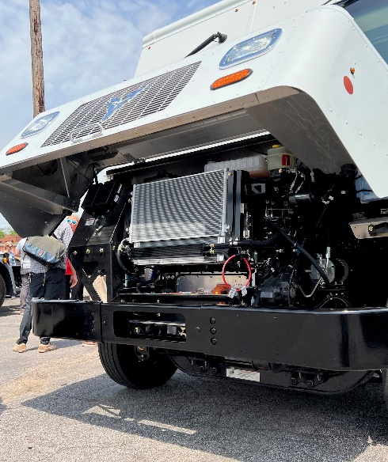


2025 Direct Current Fast Charger Installation Grant Request for Proposals (RFP) Overview
Lexie Lyng and Ethan Pieczykolan and Cindy Osborn | VW Project Managers

Slide 3
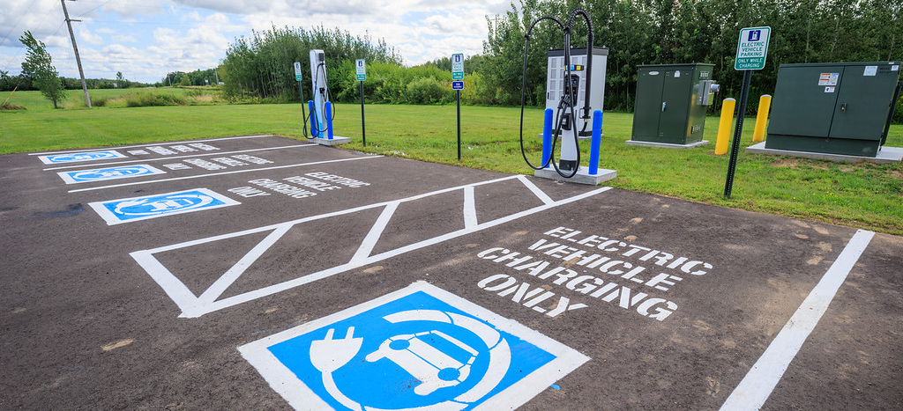
Agenda
Question and answer process
Volkswagen Settlement background
Eligible projects
How to apply
Application review process
Questions

Slide 4
Questions about the grant?
Today’s questions and answers will all be posted on the SWIFT supplier portal, so everyone can see them.
To ask a question today:
Type into the chat box, or
Use the Raise Your Hand function and we will unmute you
If you are on the phone, raise your hand by pressing *3
After today, email all questions to grants.pca@state.mn.us no later than 4 p.m. on Nov. 20, 2025 with the subject line “EV fast charging”

Slide 5

Overview: Volkswagen Settlement
In 2016 VW agreed to pay $14.7B for deliberately violating national vehicle emission standards for nitrogen oxides (NO_{X})
Minnesota received $47 million
Only 2 things the money can be spent on:
Replacing old diesel vehicles and equipment with new models
Installing electric vehicle charging stations
This is a NOx reduction program

Slide 6
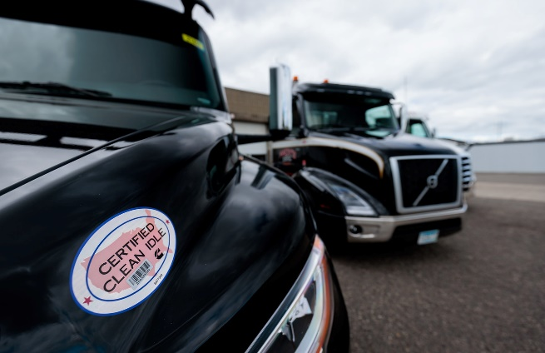
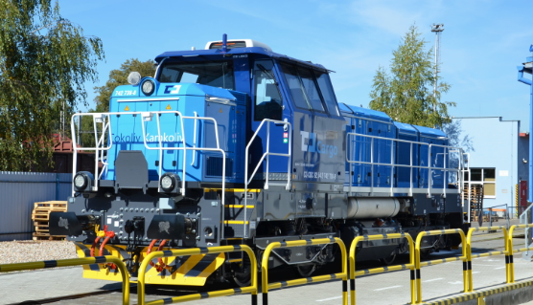


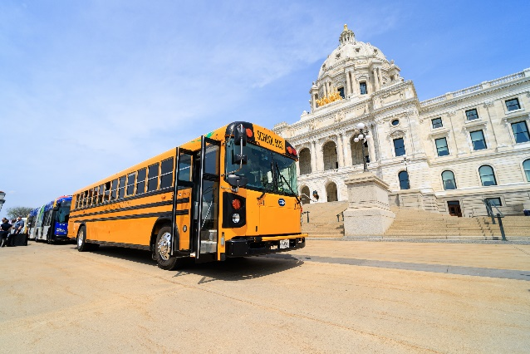

Funding Categories
Electric Vehicle Charging Station
Heavy Duty Electric Vehicles
Clean Heavy Duty On-road Vehicles
Clean Heavy Duty Off-Road Equipment
Electric School Buses
Clean School Buses

Slide 7
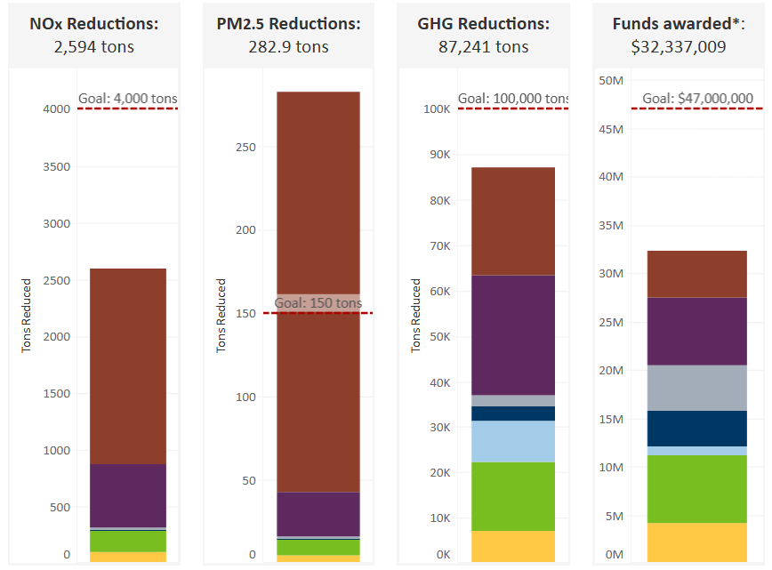
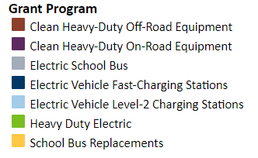
Emissions Reductions as of October 2025
Notes:
Switcher locomotives, ferries, tugs, port cargo handling equipment, ocean-going vessel shore power, Diesel Emission Reduction Act (DERA)

Slide 8
Overview: Minnesota’s Plan
Phase 1 (2018-2019): 25% of overall funds ($11.75 million)
Phase 2 (2020-2023): 50% ($23.5 million)
Phase 3 (2024-2027): 25% ($11.75 million)
Phase 1
Phase 2
Phase 3
25%
50%
25%
2018
2020
2024
2027
We are here!
Notes:
The purpose of Phase 1 was to learn and figure out how to best ways evaluate and award grants and make progress toward our long-term program goals.
We’re using a phased approach so that we could build in opportunities for public input between the phases.
You can see the results of Phase 1 on our website.
We’re now midway through Phase 2. This RFP is our single-largest grant to date.

Slide 9
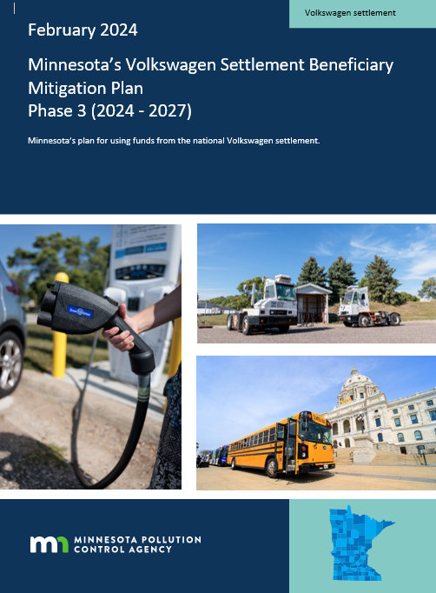
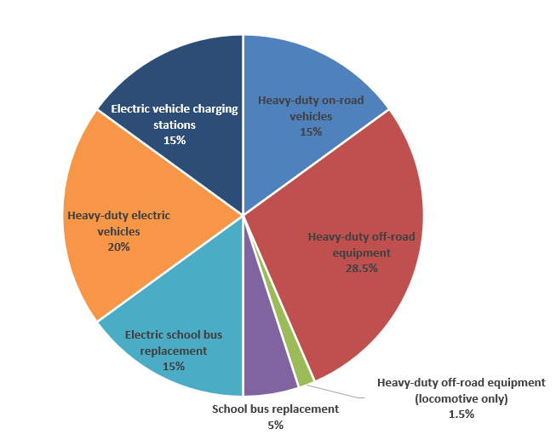
Overview: Minnesota’s Plan
Phase III: $11.75 million

Slide 10
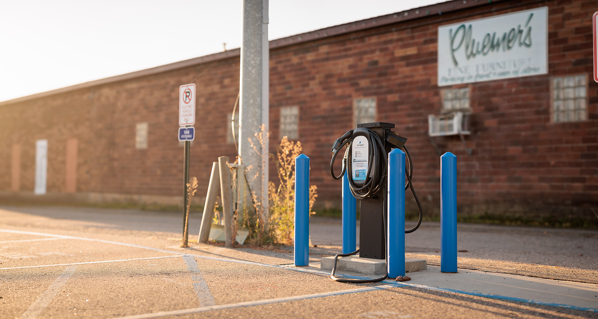
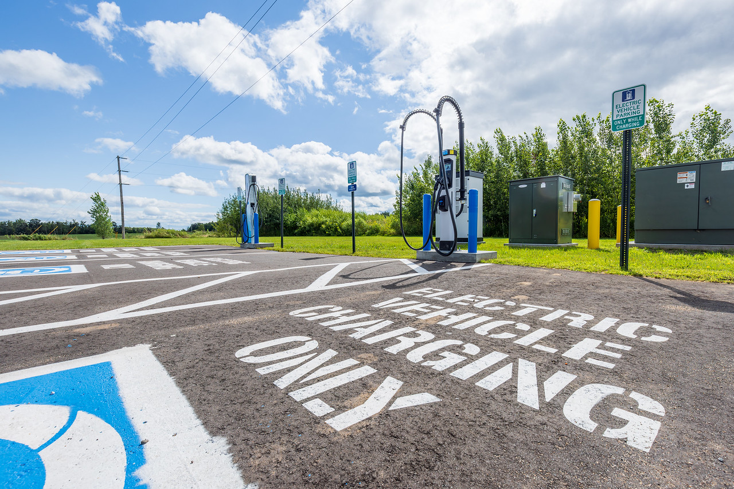
2025 Direct Current Fast Charger Installation Grant
MPCA anticipates awarding approximately $1.89 million in grants to install a minimum of 13 Direct Current (DC) Fast Charger dual port stations around Minnesota.

Slide 11
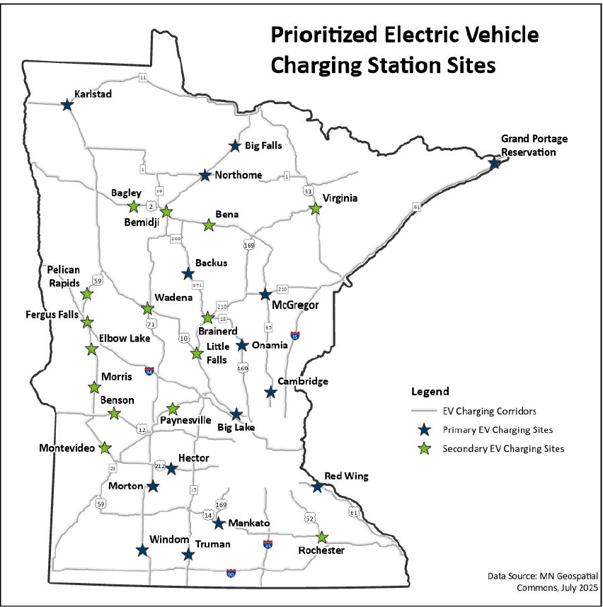
Prioritized Locations
Prioritized locations were developed using MNDOT’s Minnesota Electric Vehicle Infrastructure Needs Assessment as well as additional qualifiers
Primary and Secondary Site Selection
Additional points will be given to applicants who select a site (s) off the primary or secondary site list
Applicants may submit a site application for a non-prioritized site if it is on one of the charging corridors from the map
Sites suggested on interstates 35 and 94 will not be considered as MNDOT’s NEVI funding is focused on those corridors

Slide 12




DCFC site requirements
DCFC sites must be …
Within a short walking distance of retail/service establishments
Two miles or less from a designated EV corridor
Dusk to dawn lighting
Accessible 24/7, no less than 355 days per year

Slide 13
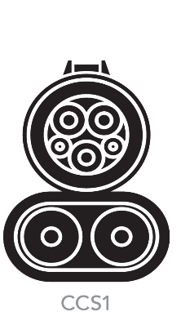


DCFC dual-port charger requirements
DCFC stations must be...
Dual-ported with one port being CCS
Minimum 150-kW dual-port station
ADA accessible for at least one parking spot

Slide 14
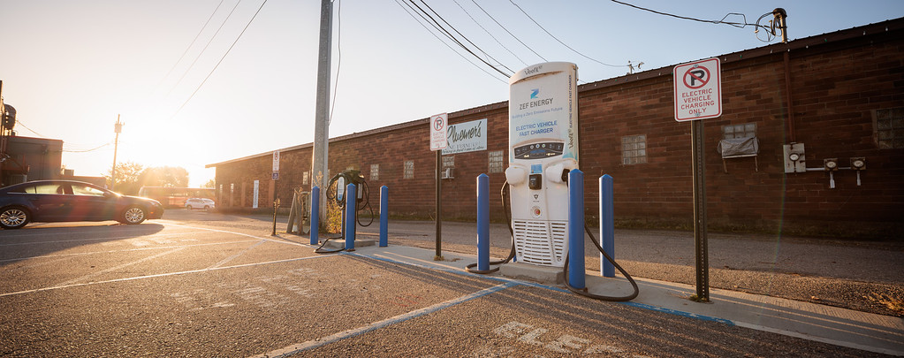
DCFC dual-port charger application requirements
Applicants may apply for as many sites as they want in the same application but may only be awarded up to 5 total sites

Slide 15
Grant overview
Total available grant funds | Approximately $1.89 million
Eligible equipment | 150 kW dual-port direct current fast charging station
Eligible sites | Sites applied for must be on one of the EV charging corridors on the map
Maximum allowable grant request | 80% of eligible project costs, up to $150,000 per 150 kW dual-port fast charging station

Slide 16

Who can apply?
Eligible applicants:
For-profit, nonprofit, and public entities, including state, local, and Tribal governments
Applicants must be based in or have a branch office in Minnesota
Ineligible applicants:
Entities or individuals suspended or debarred by the State of Minnesota and/or the federal government
MPCA may also deem an applicant ineligible because of enforcement issues, labor standards, tax status, or other issues
MPCA employees

Slide 17

Maximum allowable grant per project
The maximum award per charging station is up to
80% of eligible project costs or $150,000
**Applicants may only be awarded a maximum of 5 sites
*Eligible project costs include the cost of the new 150 kW charging station, utility equipment upgrades, concrete, asphalt,
signage, painting, permit fees, labor, shipping of equipment, 5 year service agreement, 5 warranty (see RFP for details)

Slide 18
Grant overview
Total available grant funds | Approximately $1.89 million
Eligible equipment | 150 kW dual-port direct current fast charging station
Eligible sites | Sites applied for must be on one of the EV charging corridors on the map
Maximum allowable grant request | 80% of eligible project costs, up to $150,000 per 150 kW dual-port fast charging station

Slide 19
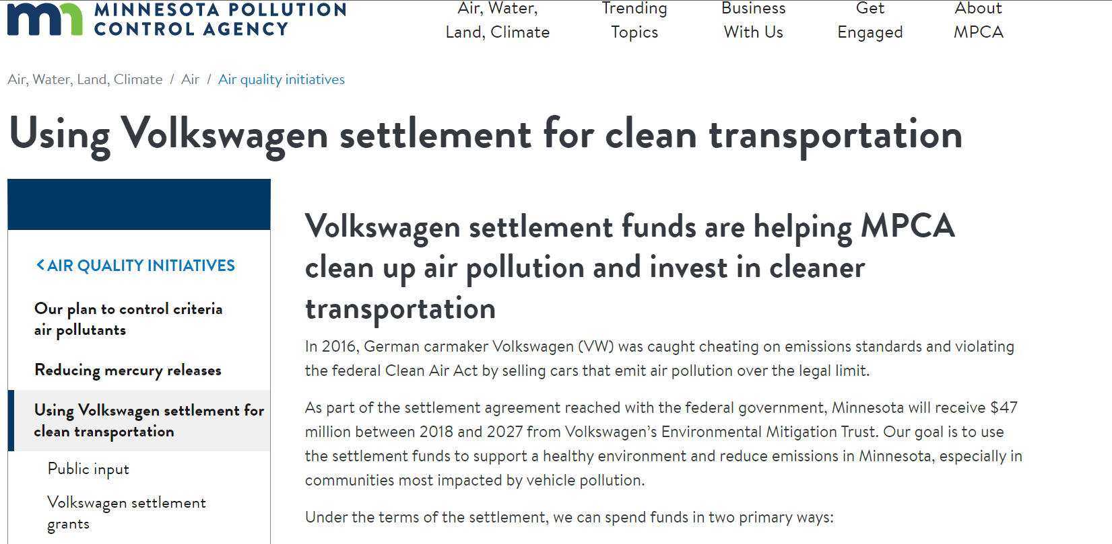
How to apply
pca.state.mn.us/air/volkswagen-settlement
Go to pca.state.mn.us/air/volkswagen-settlement
Click ‘Volkswagen settlement grants’

Slide 20
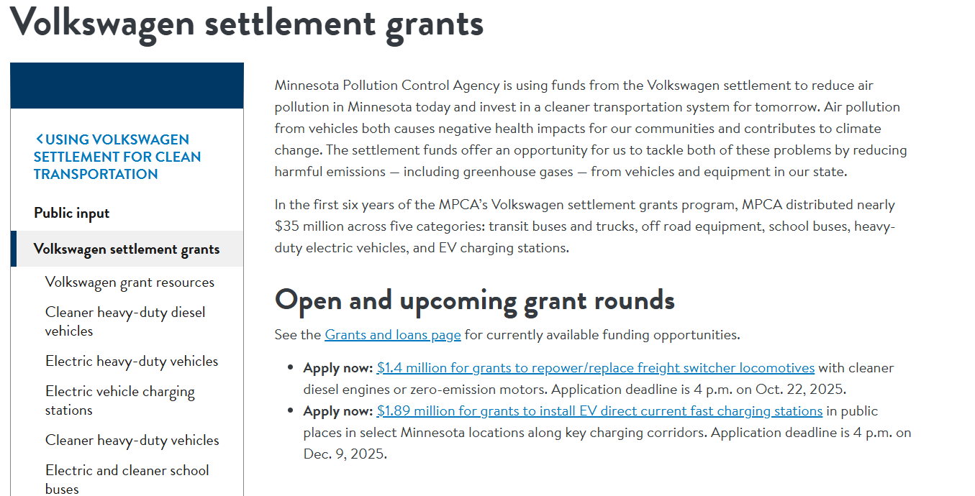
How to apply
pca.state.mn.us/air/volkswagen-settlement
Go to pca.state.mn.us/air/volkswagen-settlement
Click ‘Volkswagen settlement grants’
Click ‘Grants and loans page’

Slide 21
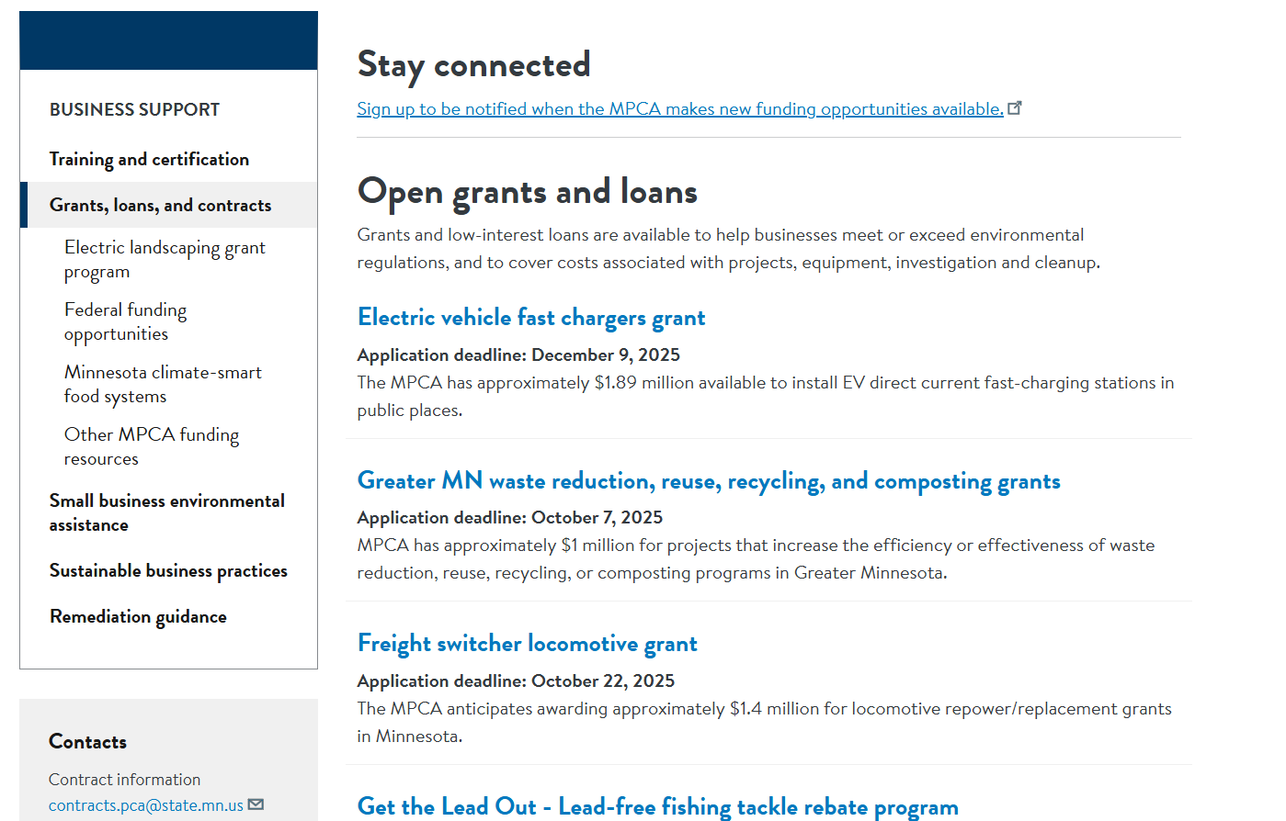
How to apply
pca.state.mn.us/air/volkswagen-settlement
Go to pca.state.mn.us/air/volkswagen-settlement
Click ‘Volkswagen settlement grants’
Click ‘Grants and loans page’
Click ‘Heavy duty on-road replacement grant’

Slide 22
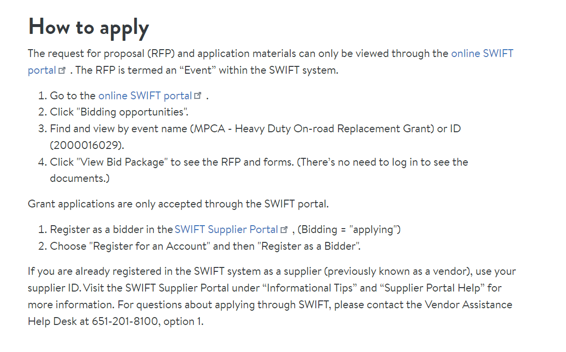
How to apply
pca.state.mn.us/air/volkswagen-settlement
Go to pca.state.mn.us/air/volkswagen-settlement
Click ‘Volkswagen settlement grants’
Click ‘Grants and loans page’
Click ‘Heavy duty on-road replacement grant’
Enter the SWIFT Supplier Portal
Notes:
Introduce Julianne

Slide 23
SWIFT Terminology & Things to Know
The Supplier Portal is “homebase” for navigating to find the RFP, applying or bidding on the RFP, and resources for questions and information.
The RFP is labeled an Event in SWIFT.
Bidding = Applying
You do not need any credentials/log-in information for viewing the RFP, application, etc.
You will have to register as a bidder to apply or bid. REGISTER AND APPLY EARLY! Do not wait until the last day to register to bid and/or upload any documents. The MPCA cannot answer questions and or help with technology related issues associated with SWIFT.
Any and all questions can be directed to the Vendor Assistance Helpdesk at 651-201-8100, option 1.

Slide 24
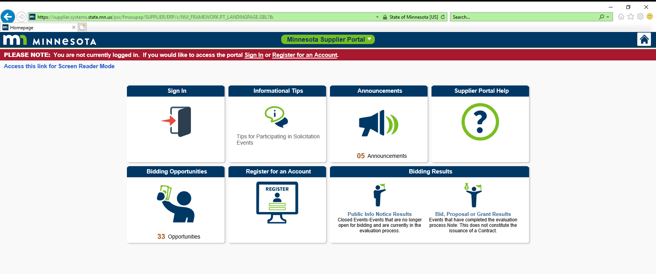
Bidding Opportunities
Click on Bidding Opportunities

Slide 25
Finding the Event/RFP
Click on “MPCA – VW phase 3 electric vehicle fast chargers”, Event ID: 2000016029
Note: May help to double click on the “Business Unit” sort feature to find Pollution Control Agency

Slide 26
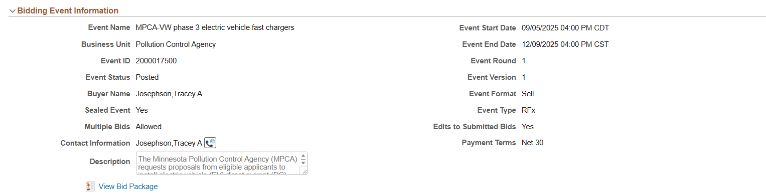
Viewing the Bid Package
Click on View Bid Package

Slide 27
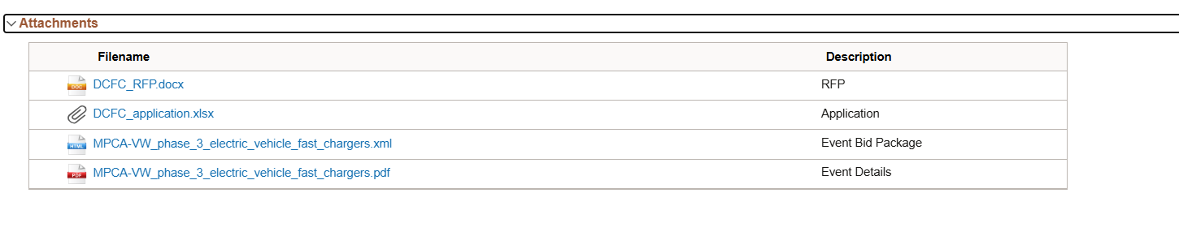
RFP and Application Materials
You can download and save the documents from here.
Note: you can ignore the last 2 items on this list

Slide 28
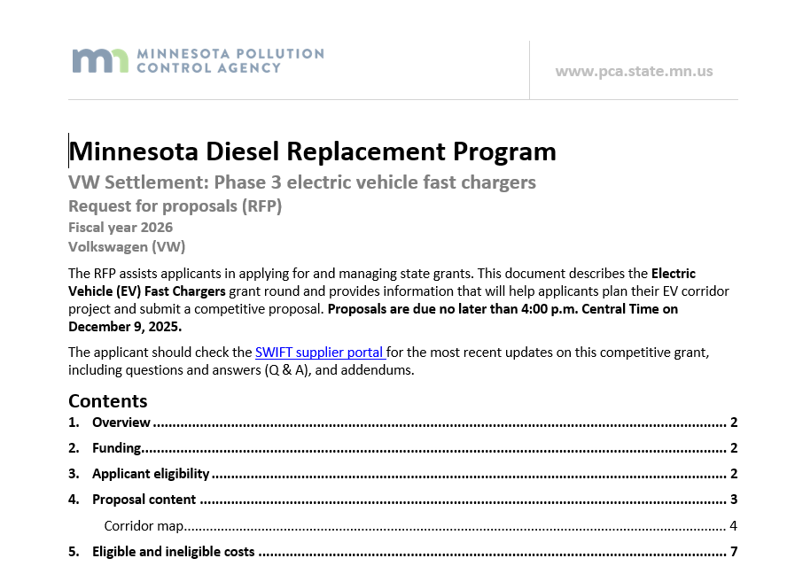
What’s an RFP?
The Request For Proposals (RFP) document assists applicants in applying for state grants.
Review the RFP before completing and submitting an application (available via the SWIFT Supplier Portal).
Other helpful documents:
Project evaluation methods
Frequently asked questions
Sample grant agreement
Applications forms
Notes:
We’ll be covering much of the material in the RFP today.

Slide 29
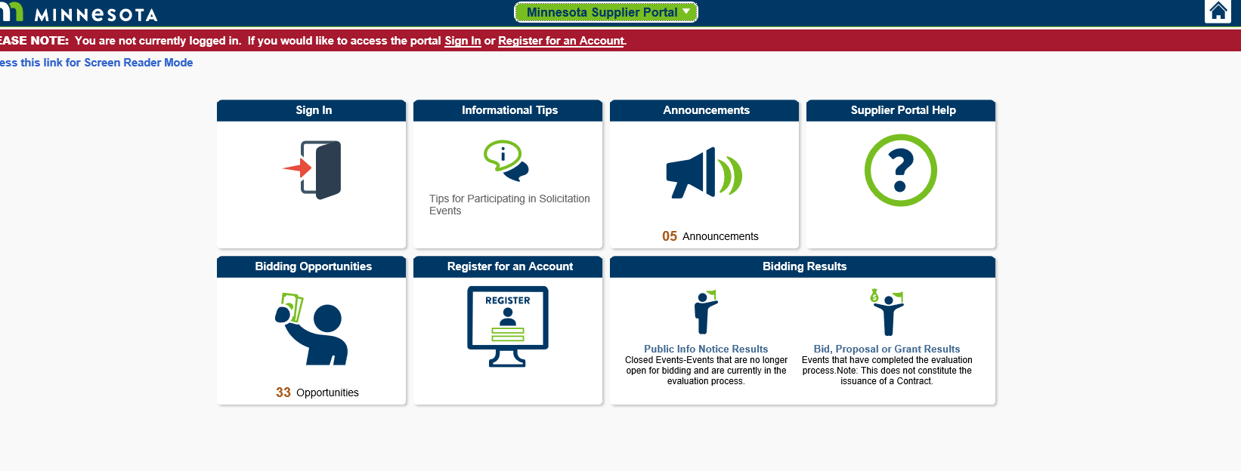
How to Apply in SWIFT
In order to apply or bid on the RFP, you must register as a bidder.
Note: If an applicant is already registered in the SWIFT system as a Supplier (previously known as a vendor), they do not need to register as a bidder. They will need their Supplier ID.
Go to the Supplier Portal Page and click on Register for an Account.

Slide 30
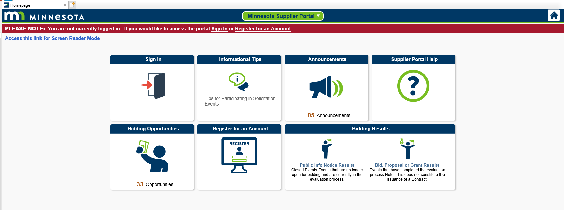
SWIFT Questions and Assistance
Questions can be directed to 651-201-8100, option 1 or by clicking on Informational Tips and Supplier Portal Help.

Slide 31
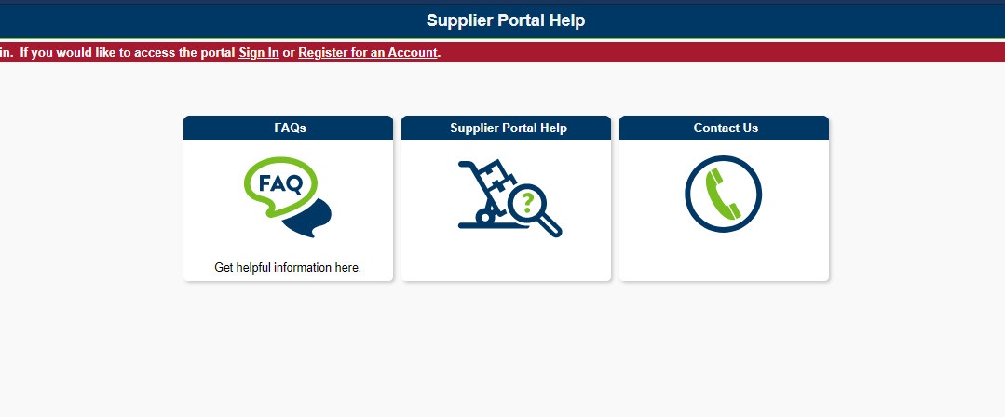
SWIFT Questions and Assistance Cont.

Slide 32
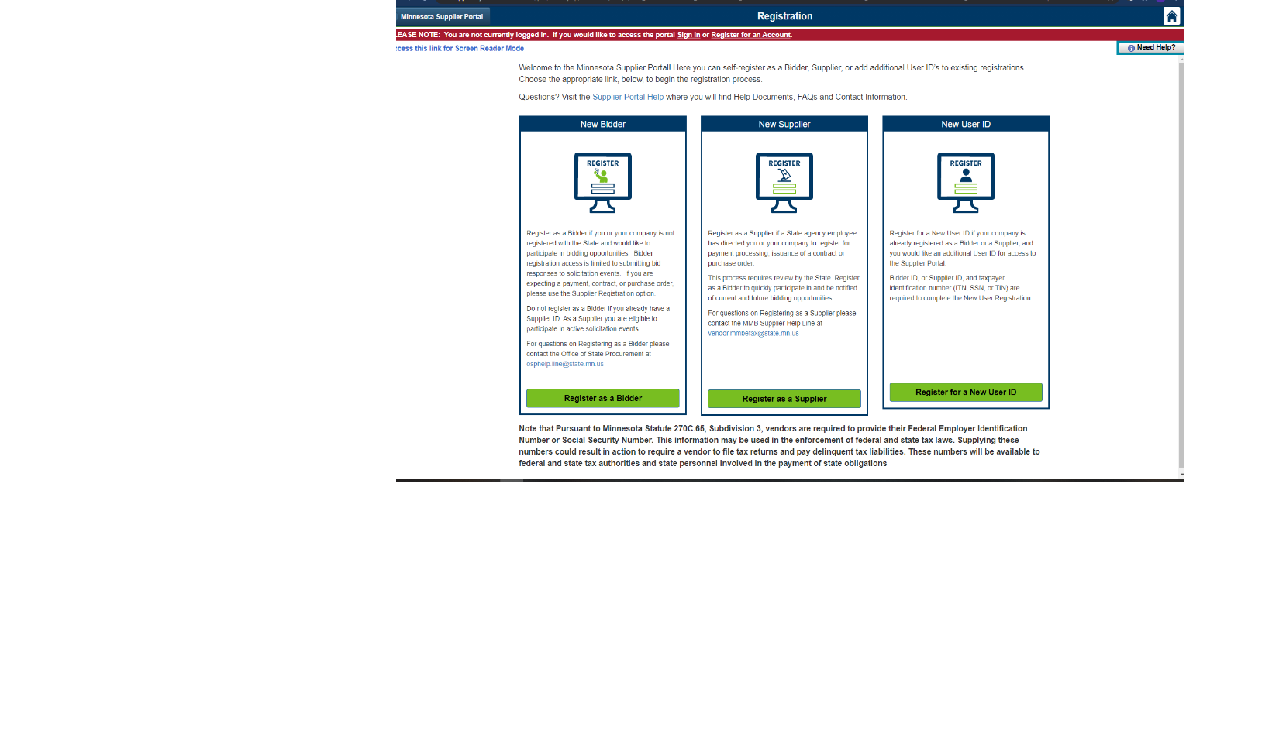
Additional Resources

Slide 33
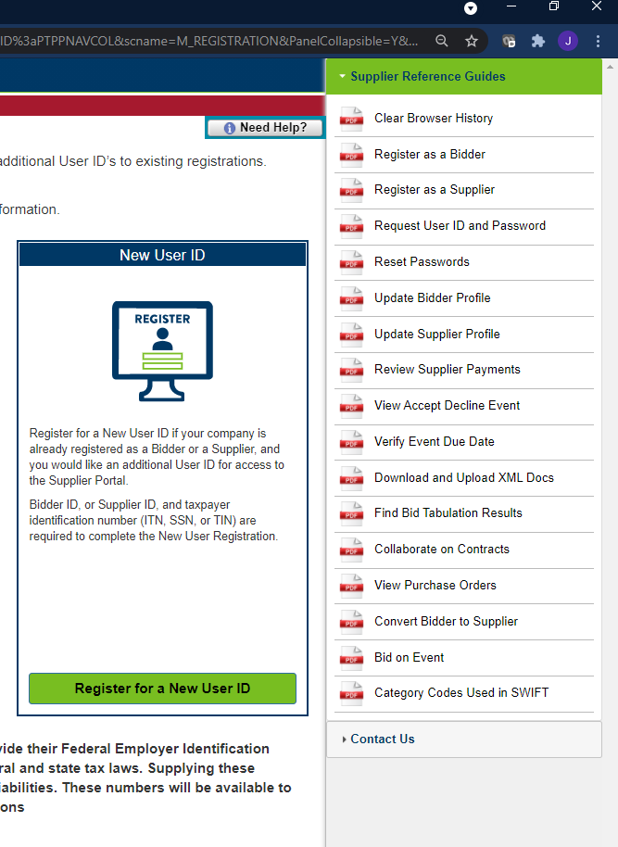
Additional Resources Cont.

Slide 34
Questions?
All questions and answers to the questions from today’s webinar are recorded and will be posted through the Supplier Portal under “View Bid Package” and “Questions and Answers”.
The webinar and slides will be posted on the grant website.
Have questions at a later date? Email them to grants.pca@state.mn.us with the subject line: “EV fast charging”
All questions need to be received no later than 4 p.m. on Nov. 20, 2025.

Slide 35
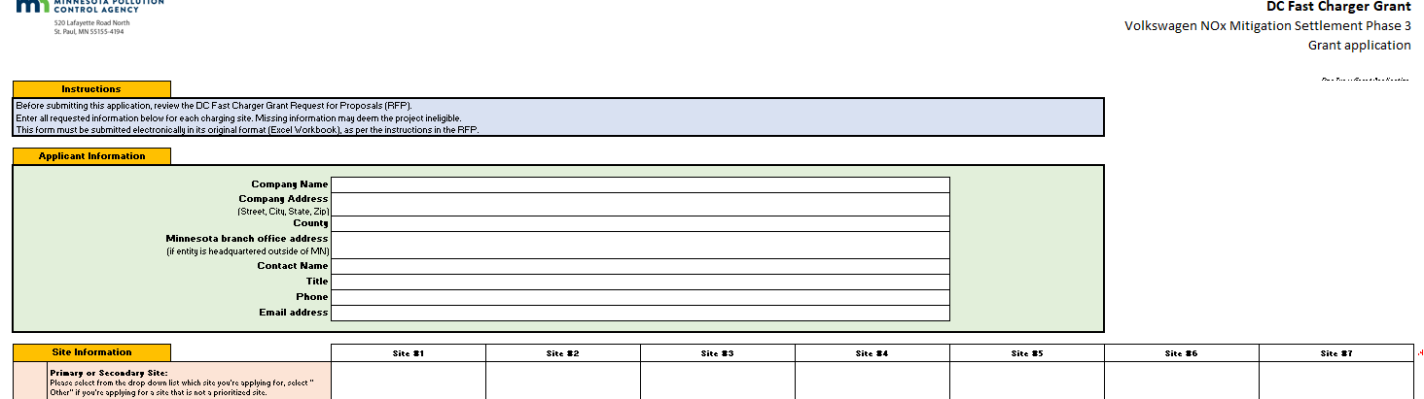
Grant application (Excel spreadsheet)
Contains all applicant and site info
Must be returned as Excel spreadsheet
No second form for this grant
Notes:
Recall that the point of these grants is to reduce emissions by retiring old diesel vehicles early; we don’t want to replace vehicles that were at the end of their life anyway.

Slide 36

Grant application – applicant info
Enter all information about your organization here
Please double-check all information
Notes:
Recall that the point of these grants is to reduce emissions by retiring old diesel vehicles early; we don’t want to replace vehicles that were at the end of their life anyway.

Slide 37
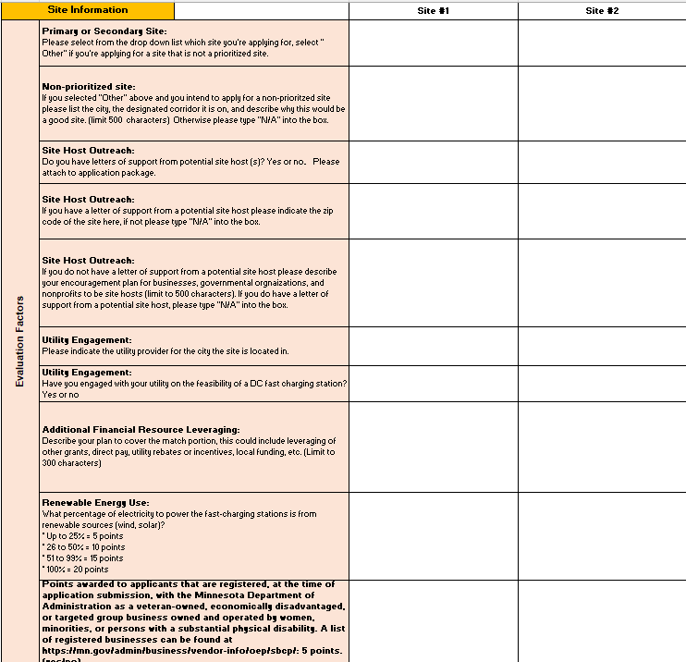
Grant application – site info
Enter all information about the site (s) you are applying for
There is no limit to the number of sites that can be requested
Include all sites on one form
Notes:
Recall that the point of these grants is to reduce emissions by retiring old diesel vehicles early; we don’t want to replace vehicles that were at the end of their life anyway.

Slide 38

Application submission
Applications are due Tuesday, December 9th at 4:00pm
Application submission checklist:
Grant Application (Microsoft Excel spreadsheet)
Letters of support from potential site hosts (optional)

Slide 39
Project Evaluations
Scoring criteria | Max. points available | Details
EV Charging Prioritized sites | 18 | Primary Site: 18 points Secondary Site : 10 points Non-prioritized site: 0 points
Cost | 22 | Lowest total grant amount request for the site will get 22 points (formula for scoring = lowest ÷ next lowest score x 22% = # of points)
Site Host Outreach | 20 | 5 points for outreach plan 20 points for site host letter of support (This does not lock you into this site host but demonstrates your outreach and forethought)
Utility Engagement | 10 | Please indicate the utility provider for the city the site is located in. Have you engaged with your utility on the feasibility of a DCFC?
Additional Financial Resource Leveraging | 5 | Describe plan to cover match portion, this could include leveraging of other grants, direct pay, utility rebates or incentives, local funding, etc.
Renewable Energy Use | 20 | Percentage of electricity to power the fast-charging stations is from renewable sources (wind, solar).
Small Business procurement program | 5 | Points awarded to applicants that are registered, at the time of application submission, with the Minnesota Department of Administration as a veteran-owned, economically disadvantaged, or targeted group business owned and operated by women, minorities, or persons with a substantial physical disability
Total | 100

Slide 40

Timeline
Applications close (12/09)
RFP scoring
Award notifications
Funding request
Contract signing
Grantee responsibilities
Reimbursement

Slide 41
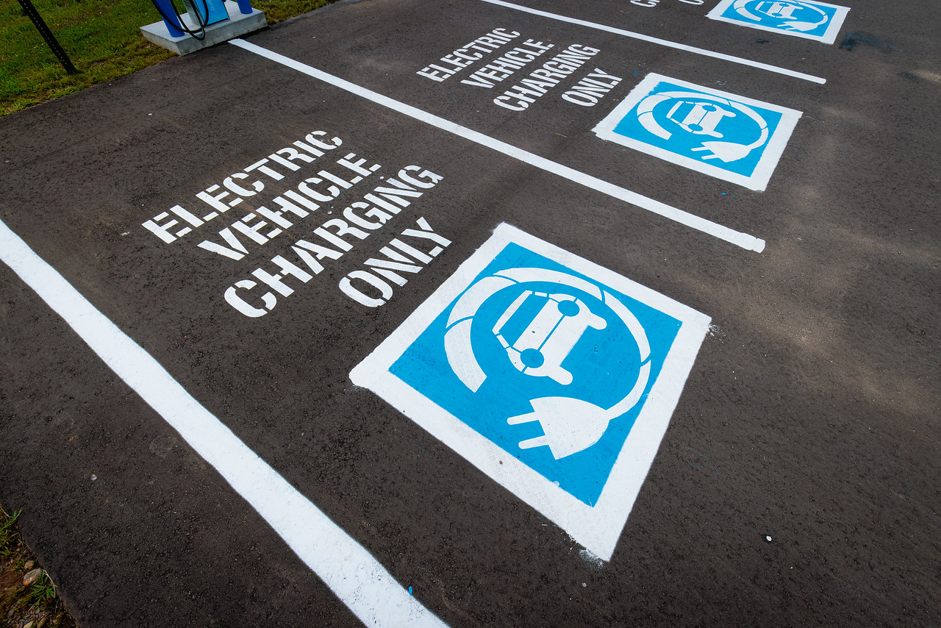
Grantee responsibilities (if awarded)
Before receiving a grant reimbursement, grantees must…
Sign a grant agreement form
Enter into site host agreement
Purchase the new charger
Work with an installer to install the charger
Retain all invoices pertaining to charger, utility upgrades, and installation
Submit the paid-in-full invoice for the charger and all other invoiceable expenses

Slide 42
Questions?
VW grants webpage: pca.state.mn.us/air/Volkswagen-settlement
After today, all questions should be submitted to grants.pca@state.mn.us by 4 p.m. on Nov. 20, 2025.
Applications due Tuesday, December 9th at 4:00 pm
Firstname Lastname
firstname.lastname@state.mn.us
555-555-5555

